Slide 1
Chapter 04: Basic Concepts in Number Theory and Finite Fields
Freshman Seminar
2022.01.11
Sumin Sohn

Slide 2
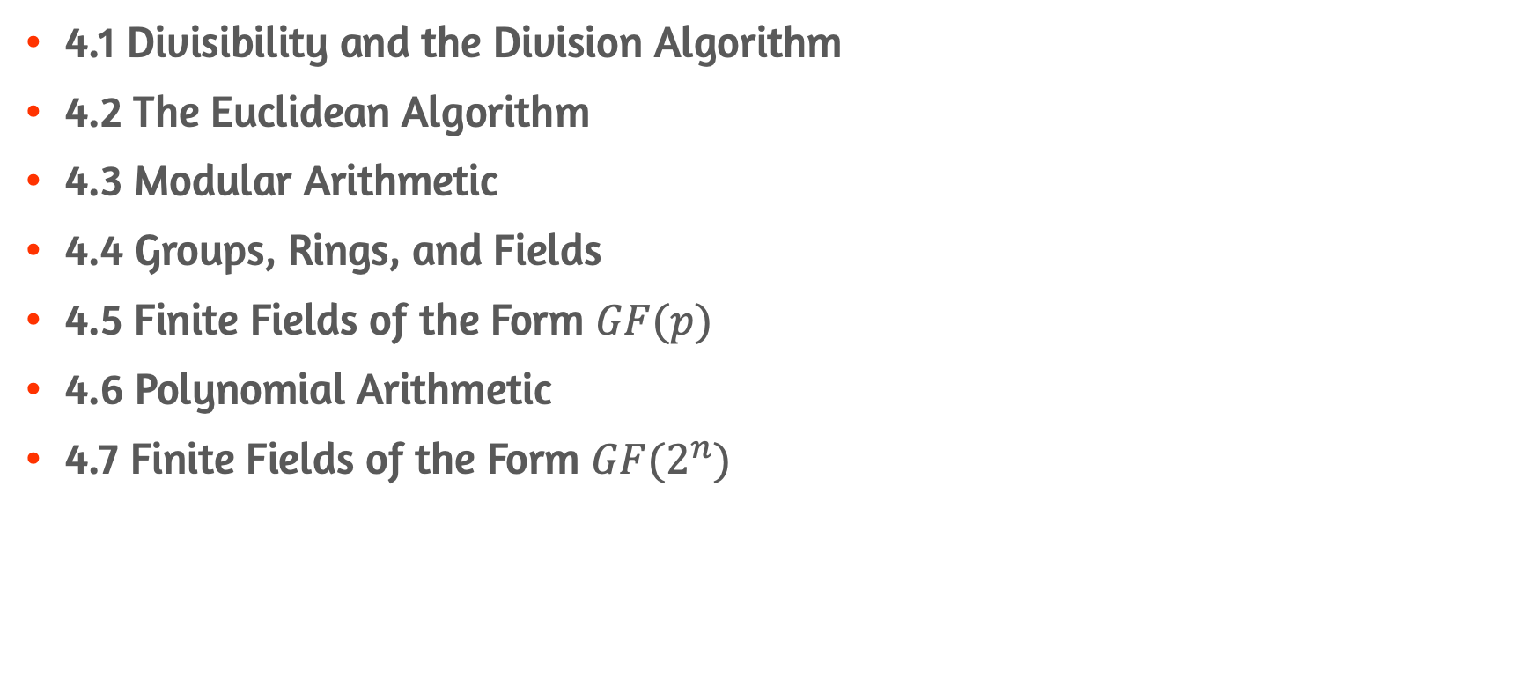
Contents
4.1 Divisibility and the Division Algorithm
4.2 The Euclidean Algorithm
4.3 Modular Arithmetic
4.4 Groups, Rings, and Fields
4.5 Finite Fields of the Form $GF(p)$
4.6 Polynomial Arithmetic
4.7 Finite Fields of the Form $GF(2^{n})$

Slide 3
4.1 Divisibility and the Division Algorithm

Slide 4
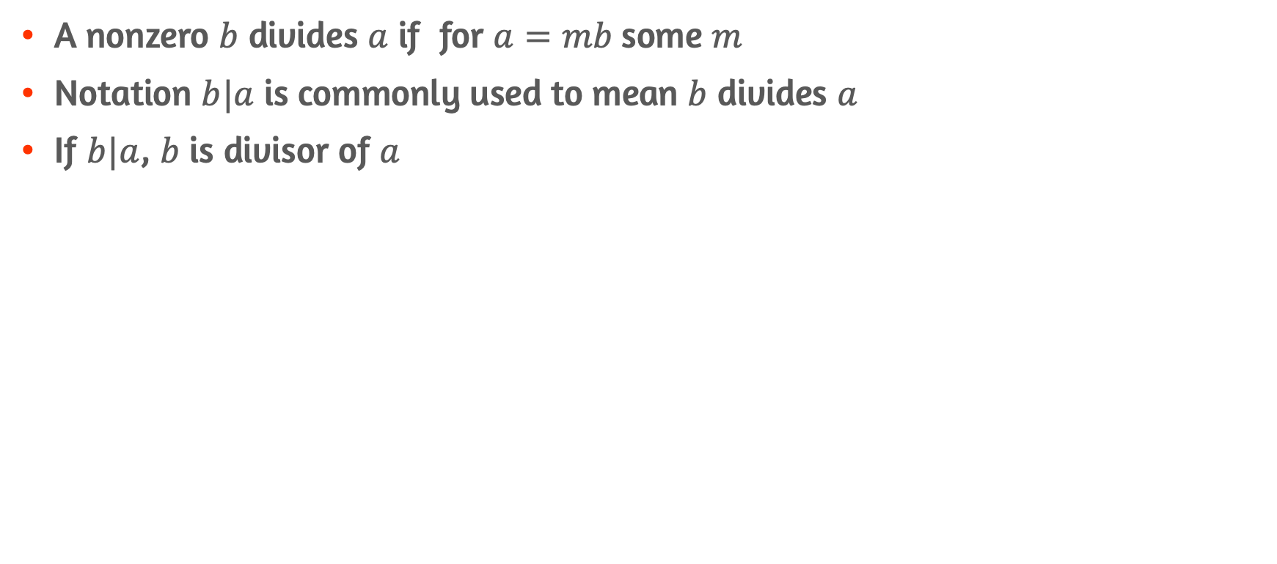
Divisibility
A nonzero $b$ divides $a$ if for $a=mb$some $m$
Notation $b|a$ is commonly used to mean $b$ divides $a$
If $b|a$, $b$ is divisor of $a$

Slide 5
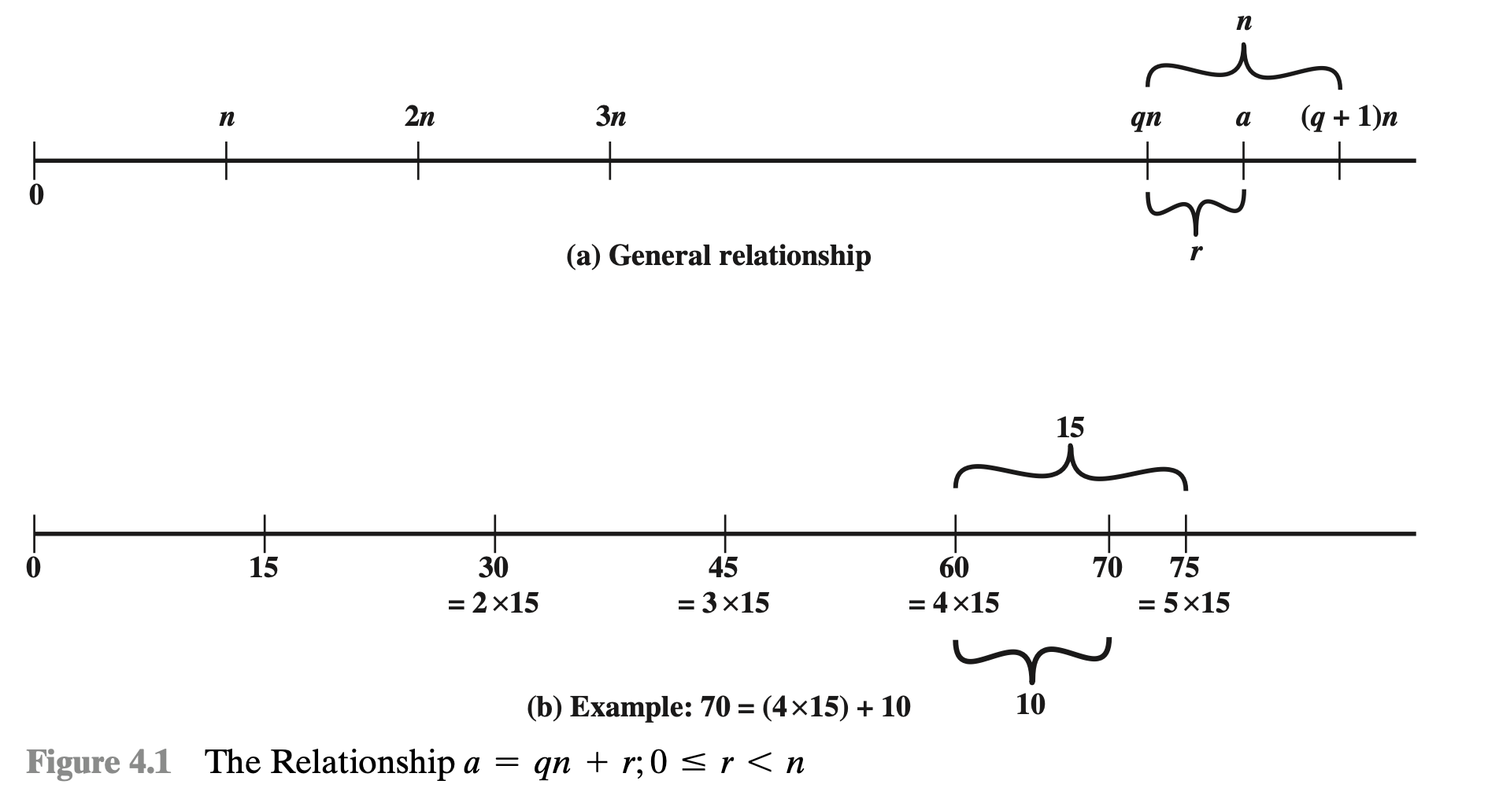
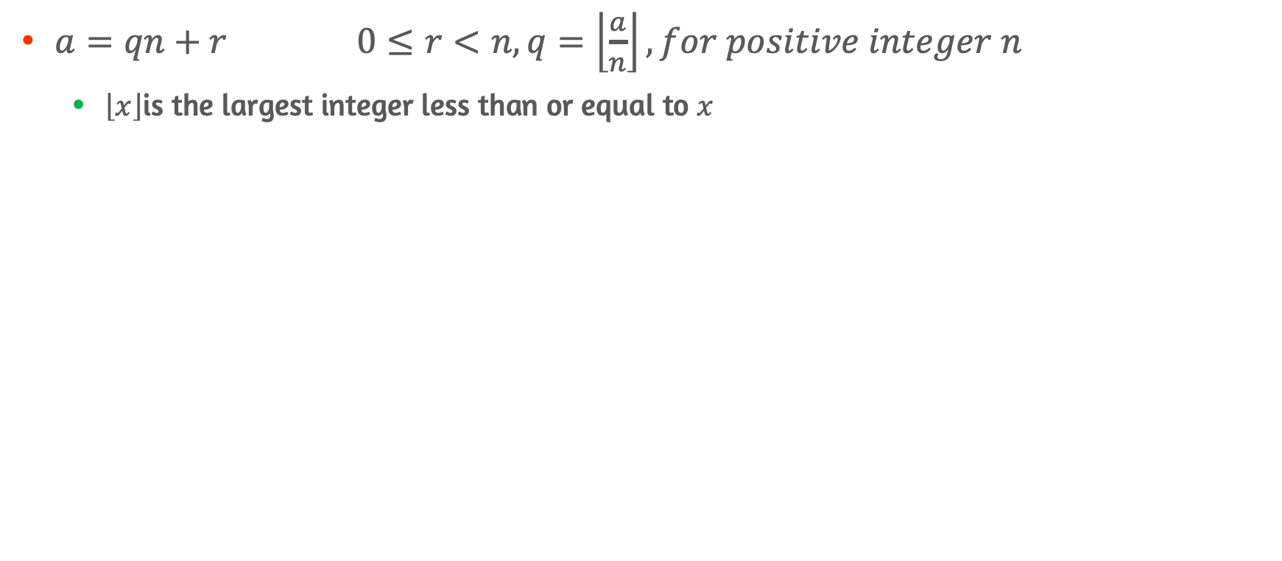
The Division Algorithm
$a=qn+r 0≤r<n, q=\left\lfloor \frac{a}{n}\right\rfloor , for positive integer n$
$\left\lfloor x\right\rfloor$is the largest integer less than or equal to $x$

Slide 6
4.2 The Euclidean Algorithm

Slide 7
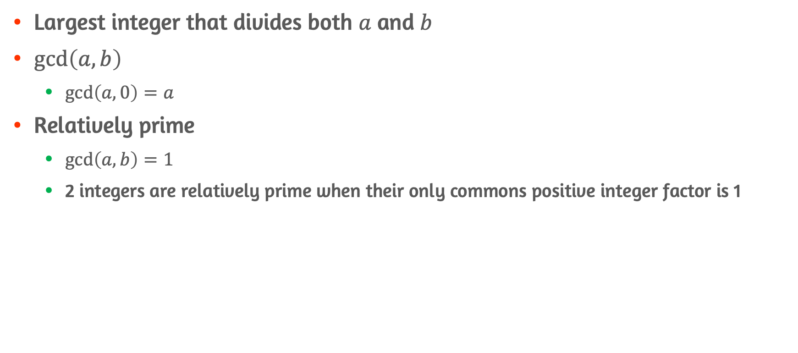
Greatest Common Divisor(GCD)
Largest integer that divides both $a$ and $b$
$\gcd\left(a,b\right)$
$\gcd\left(a,0\right)=a$
Relatively prime
$\gcd\left(a,b\right)=1$
2 integers are relatively prime when their only commons positive integer factor is 1

Slide 8
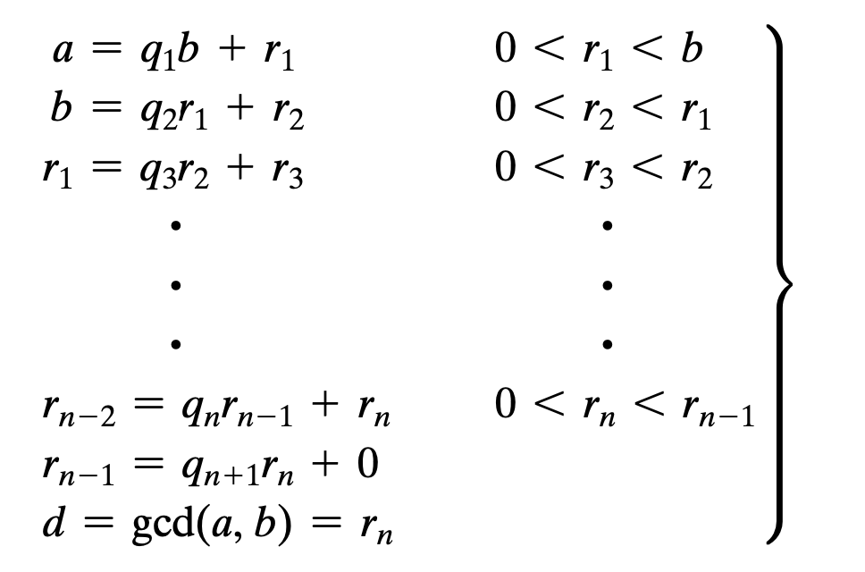
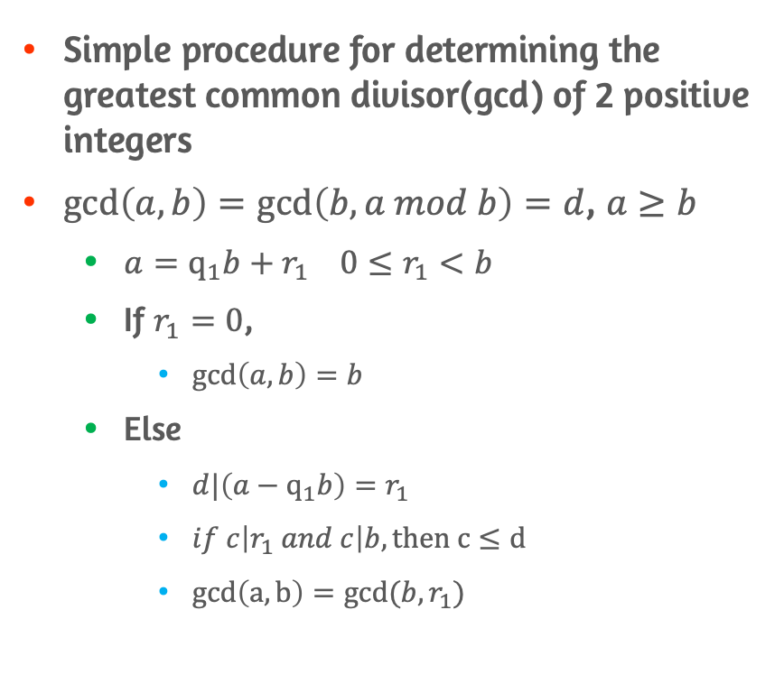
Euclidean Algorithm
Simple procedure for determining the greatest common divisor(gcd) of 2 positive integers
$\gcd\left(a,b\right)=\gcd\left(b,a mod b\right)=d$, $a≥b$
$a=q_{1}b+r_{1} 0≤r_{1}<b$
If $r_{1}=0$,
$\gcd\left(a,b\right)=b$
Else
$d|\left({a−q}_{1}b\right)=r_{1}$
$if c\left|r_{1} and c\right|b, then c≤d$
$gcd\left(a,b\right)=gcd⁡(b,r_{1})$

Slide 9
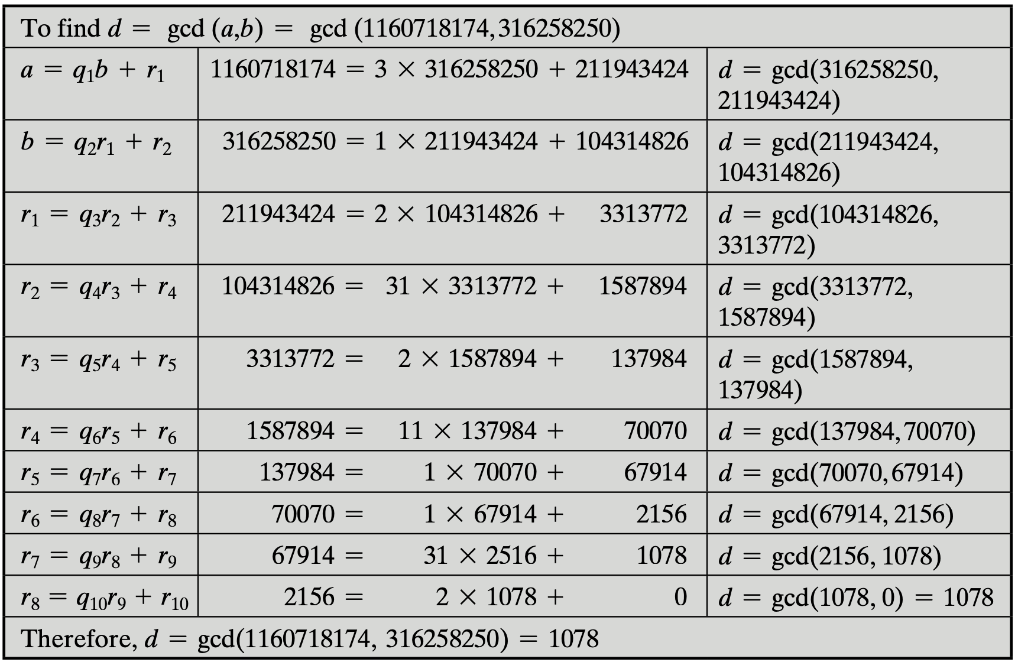
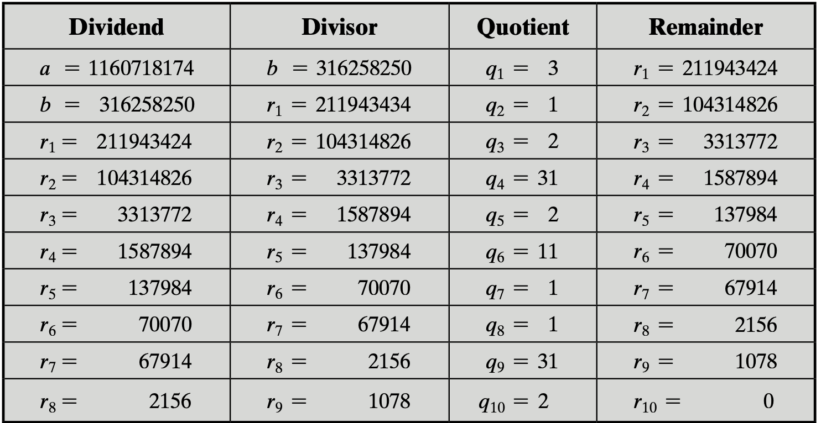
Euclidean Algorithm(example)

Slide 10
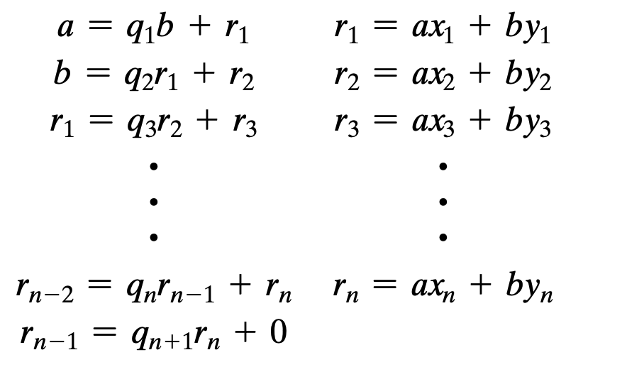
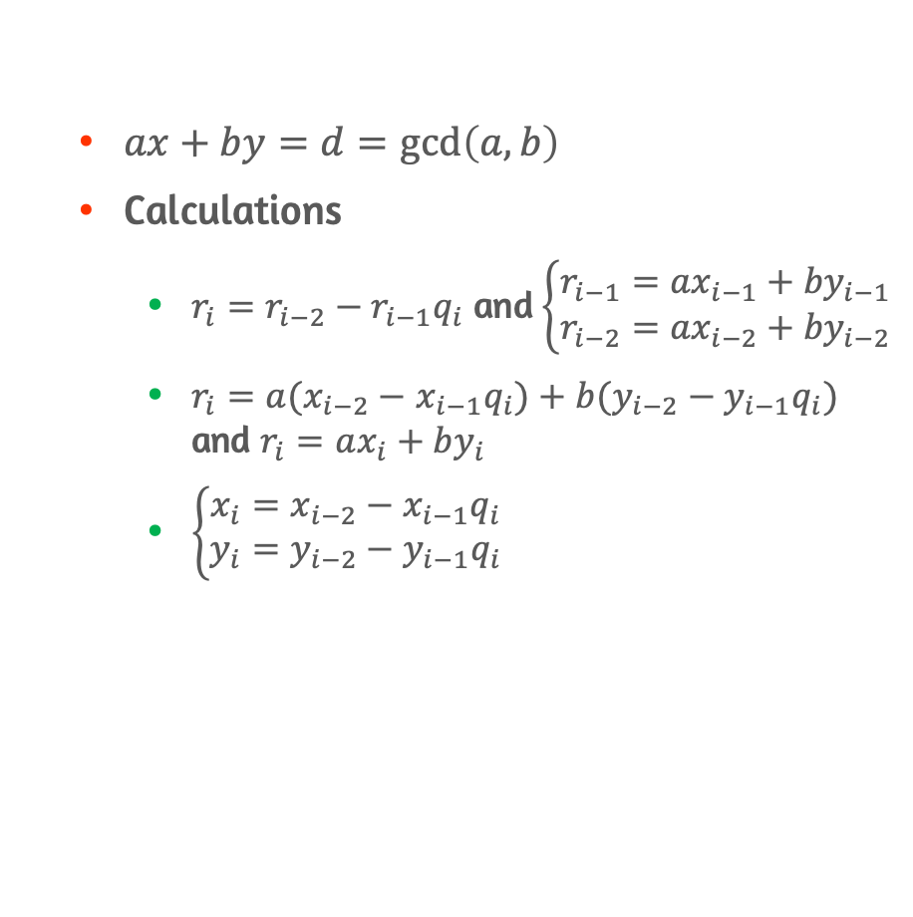
Extended Euclidean Algorithm
$ax+by=d=\gcd\left(a,b\right)$
Calculations
$r_{i}=r_{i−2}−r_{i−1}q_{i}$ and $\left\{\begin{aligned}r_{i−1}={ax}_{i−1}+{by}_{i−1} \\ r_{i−2}={ax}_{i−2}+{by}_{i−2}\end{aligned}\right.$
$r_{i}=a(x_{i−2}−$ ${x_{i−1}q}_{i})+b(y_{i−2}−y_{i−1}q_{i})$ and $r_{i}=ax_{i}+by_{i}$
$\left\{\begin{aligned}x_{i}=x_{i−2}−{x_{i−1}q}_{i} \\ y_{i}=y_{i−2}−y_{i−1}q_{i}\end{aligned}\right.$

Slide 11
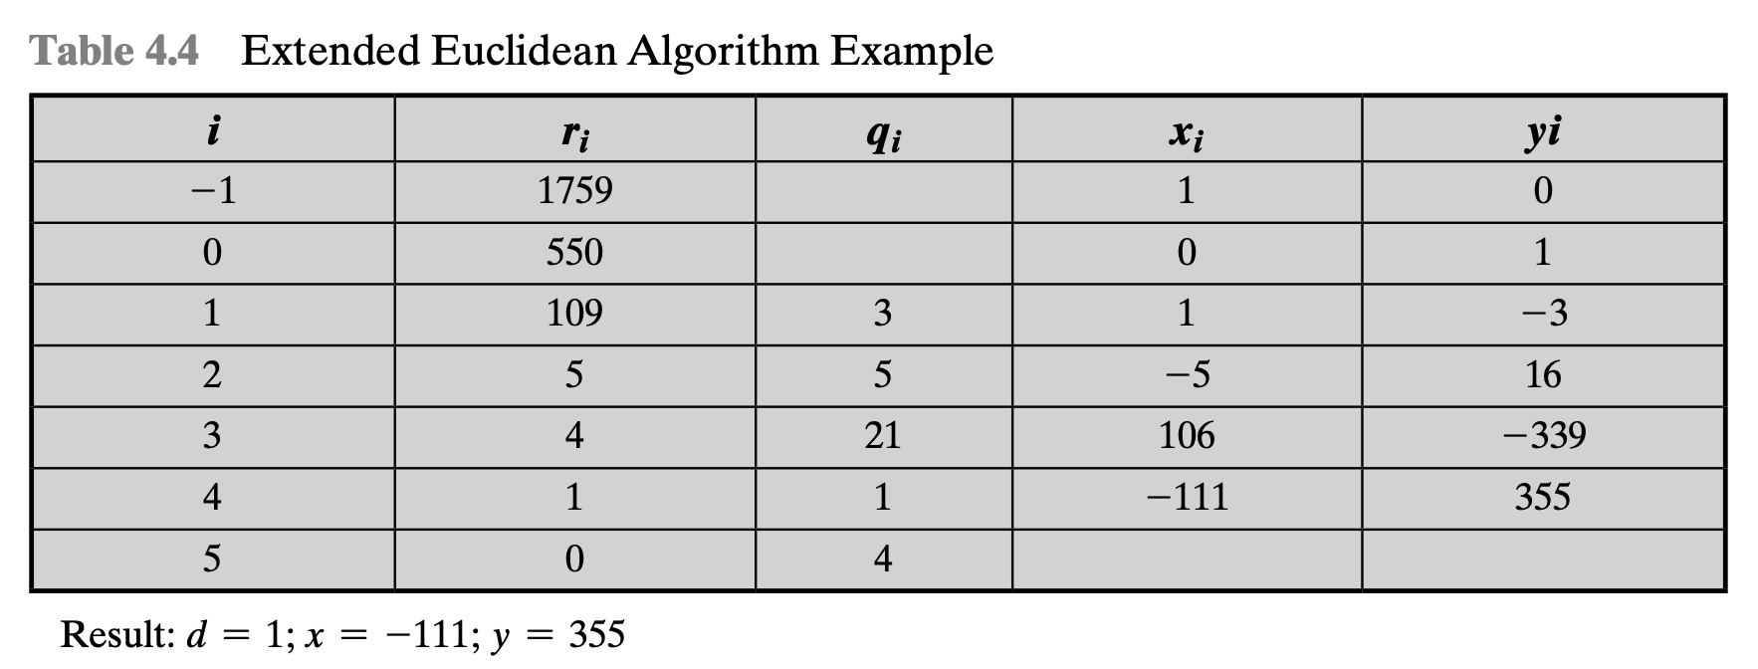
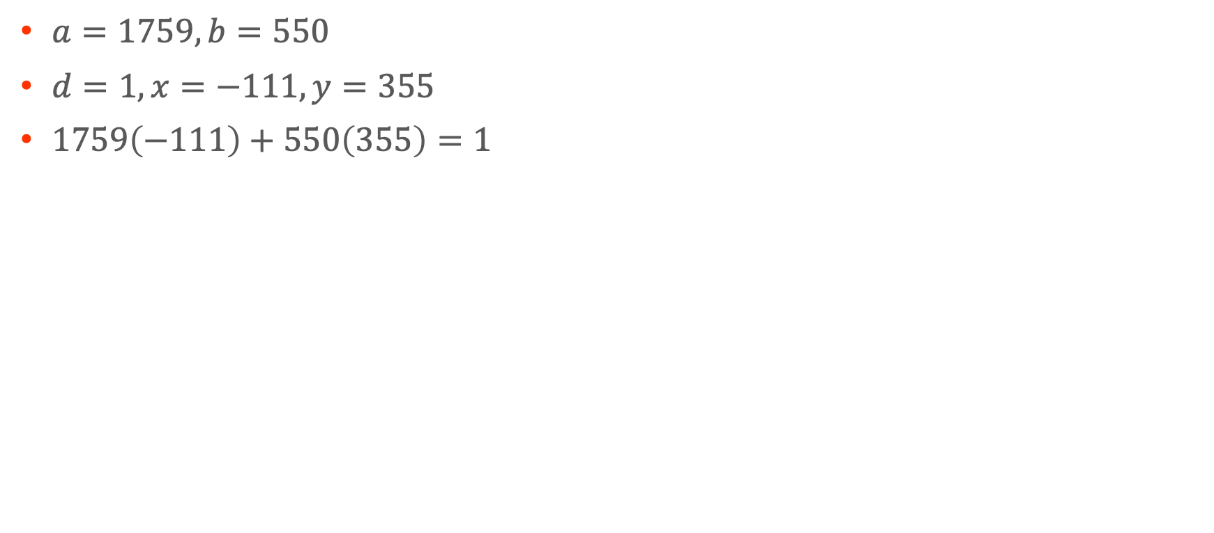
Extended Euclidean Algorithm(example)
$a=1759, b=550$
$d=1, x=−111, y=355$
$1759\left(−111\right)+550\left(355\right)=1$

Slide 12
4.3 Modular Arithmetic

Slide 13
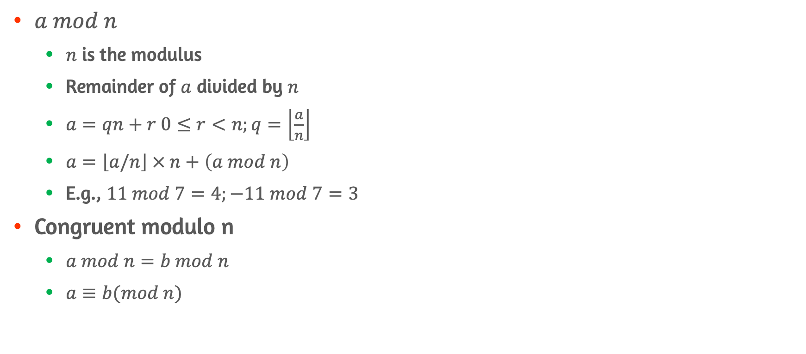
The modulus
$a mod n$
$n$ is the modulus
Remainder of $a$ divided by $n$
$a=qn+r 0≤r<n;q=\left\lfloor \frac{a}{n}\right\rfloor$
$a=\left\lfloor a/n\right\rfloor × n+\left(a mod n\right)$
E.g., $11 mod 7=4;−11 mod 7=3$
Congruent modulo n
$a mod n=b mod n$
$a≡b(mod n)$

Slide 14
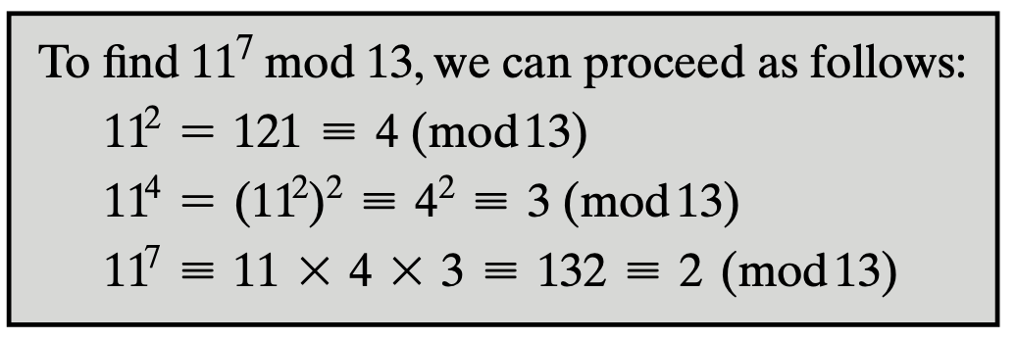
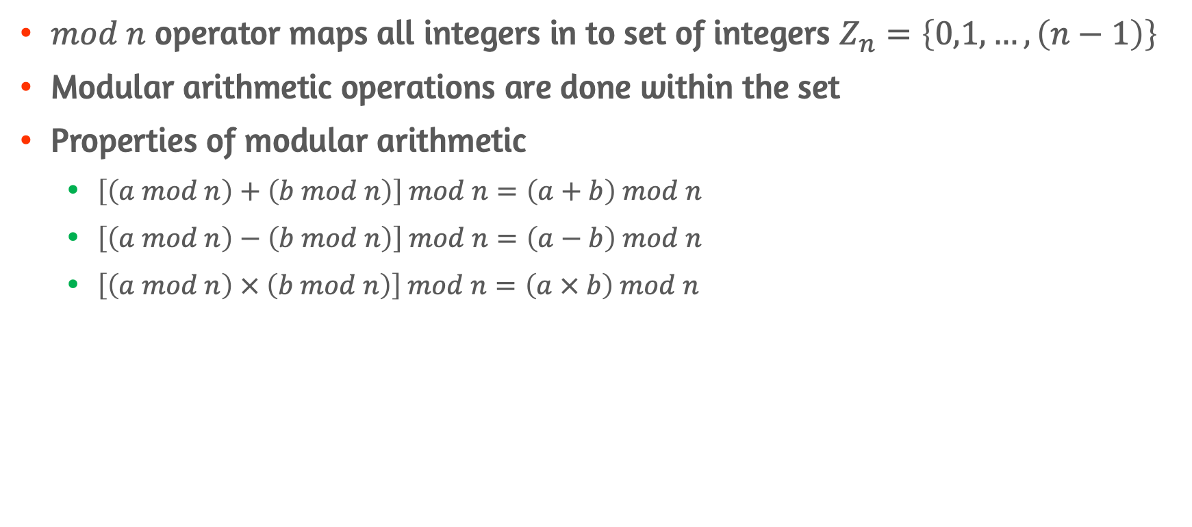
Modular Arithmetic Operations
$mod n$ operator maps all integers in to set of integers $Z_{n}=\left\{0,1,…,\left(n−1\right)\right\}$
Modular arithmetic operations are done within the set
Properties of modular arithmetic
$\left[\left(a mod n\right)+\left(b mod n\right)\right] mod n=\left(a+b\right) mod n$
$\left[\left(a mod n\right)−\left(b mod n\right)\right] mod n=\left(a−b\right) mod n$
$\left[\left(a mod n\right) × \left(b mod n\right)\right] mod n=\left(a × b\right) mod n$

Slide 15
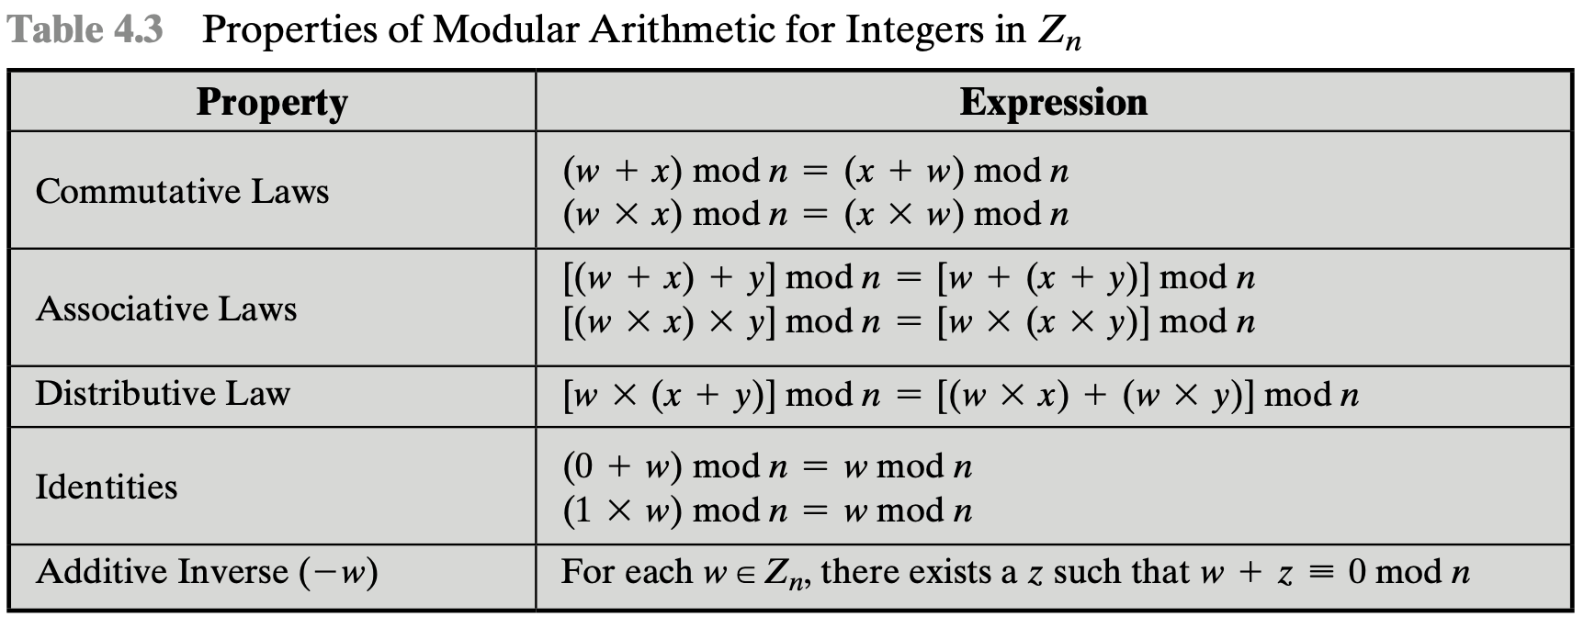
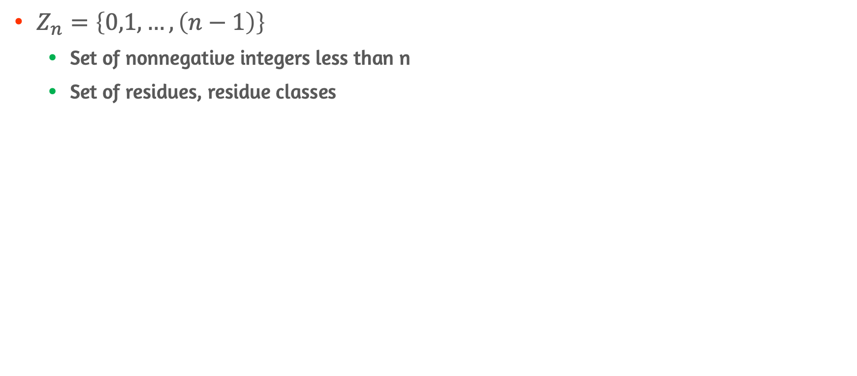
Properties of Modular Arithmetic
$Z_{n}=\left\{0,1,…,\left(n−1\right)\right\}$
Set of nonnegative integers less than n
Set of residues, residue classes

Slide 16
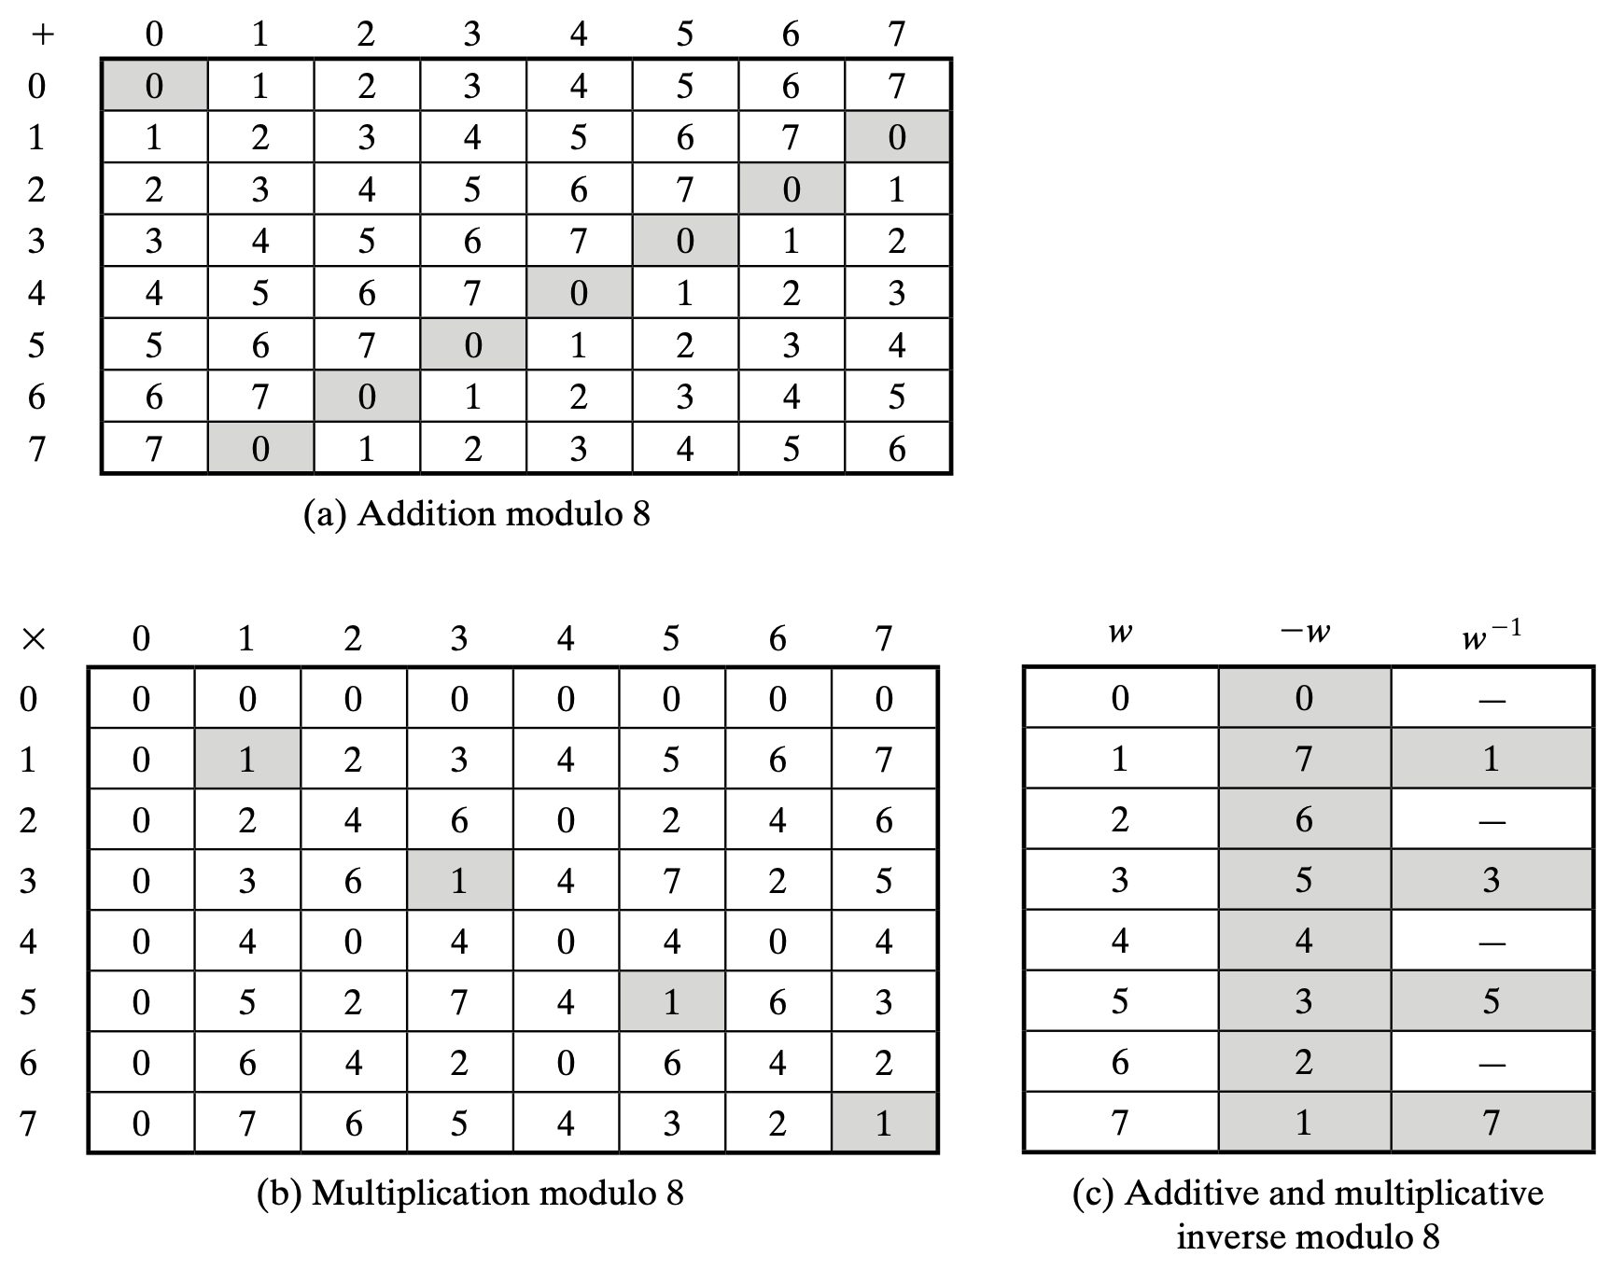
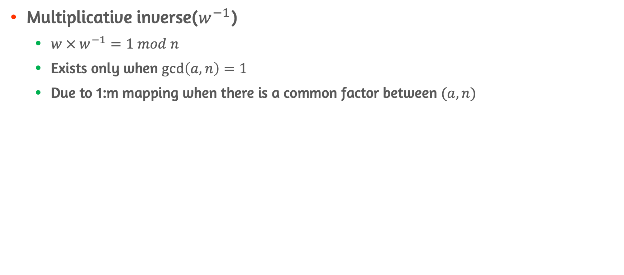
Multiplicative inverse of Modular Arithmetic
Multiplicative inverse($w^{−1}$)
$w × w^{−1}=1 mod n$
Exists only when $\gcd\left(a,n\right)=1$
Due to 1:m mapping when there is a common factor between $(a,n)$

Slide 17
4.4 Groups, Rings, and Fields

Slide 18
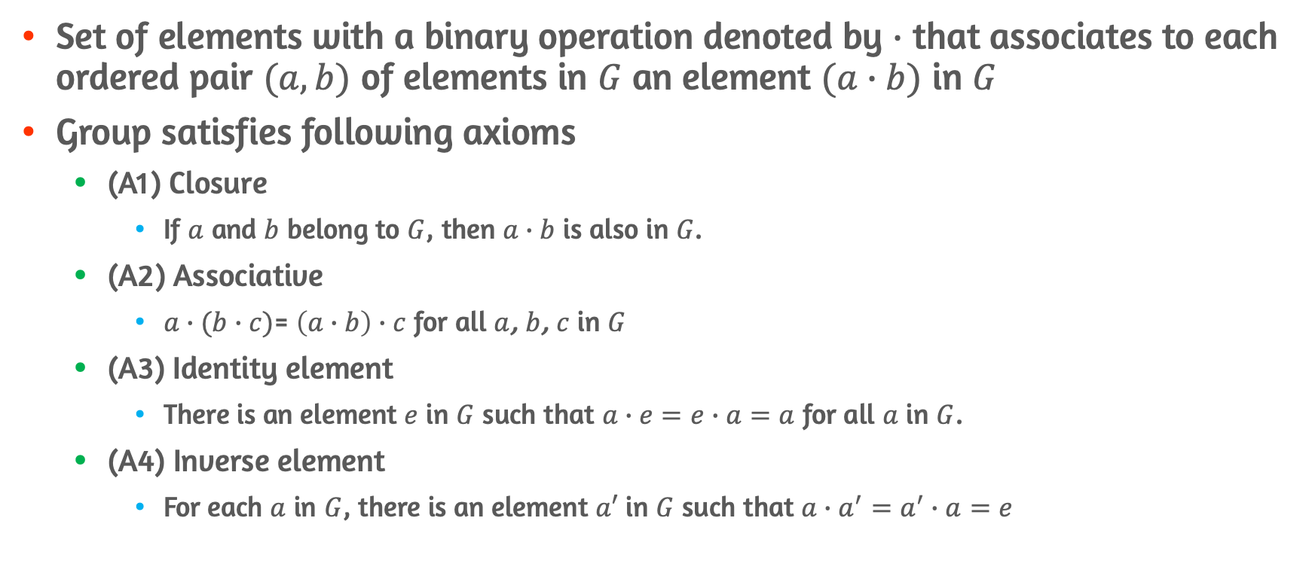

Groups $\{G,∙\}$ #1
Set of elements with a binary operation denoted by $∙$ that associates to each ordered pair $(a,b)$ of elements in $G$ an element $(a∙b)$ in $G$
Group satisfies following axioms
(A1) Closure
If $a$ and $b$ belong to $G$, then $a∙b$ is also in $G$.
(A2) Associative
$a∙(b∙c)$= $\left(a∙b\right)∙c$ for all $a$, $b$, $c$ in $G$
(A3) Identity element
There is an element $e$ in $G$ such that $a∙e=e∙a=a$ for all $a$ in $G$.
(A4) Inverse element
For each $a$ in $G$, there is an element $a′$ in $G$ such that $a∙a^{′}=a^{′}∙a=e$

Slide 19
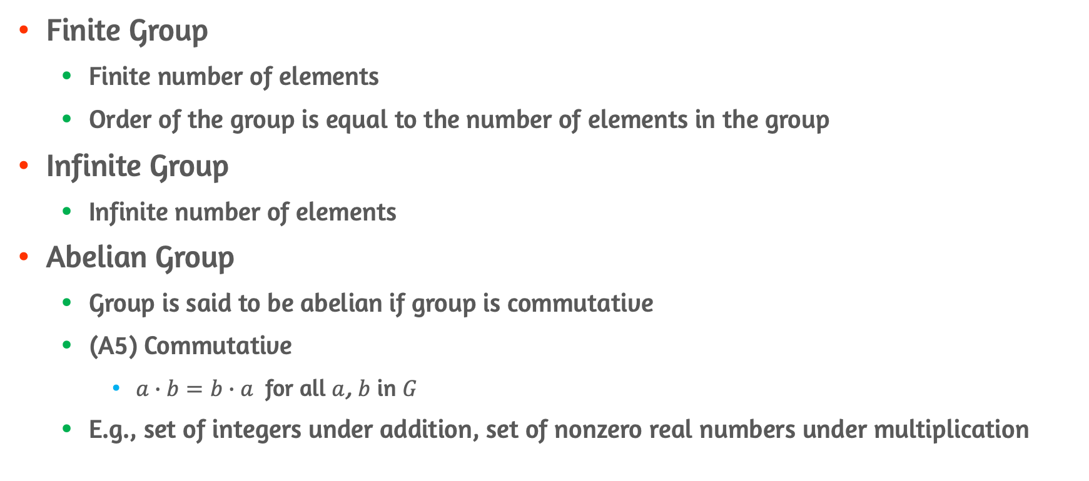

Groups $\{G,∙\}$ #2
Finite Group
Finite number of elements
Order of the group is equal to the number of elements in the group
Infinite Group
Infinite number of elements
Abelian Group
Group is said to be abelian if group is commutative
(A5) Commutative
$a∙b=b∙a$ for all $a$, $b$ in $G$
E.g., set of integers under addition, set of nonzero real numbers under multiplication

Slide 20
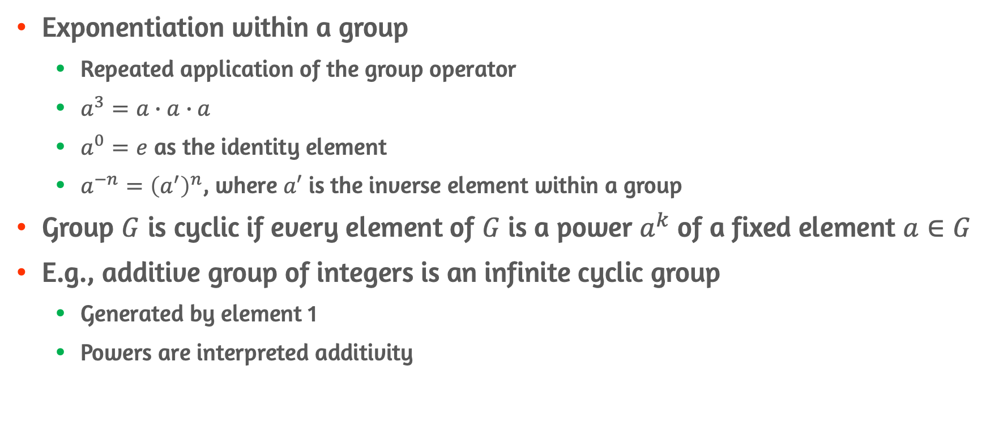
Cyclic Group
Exponentiation within a group
Repeated application of the group operator
$a^{3}=a∙a∙a$
$a^{0}=e$ as the identity element
$a^{−n}={\left(a^{′}\right)}^{n}$, where $a′$ is the inverse element within a group
Group $G$ is cyclic if every element of $G$ is a power $a^{k}$ of a fixed element $a∈G$
E.g., additive group of integers is an infinite cyclic group
Generated by element 1
Powers are interpreted additivity

Slide 21
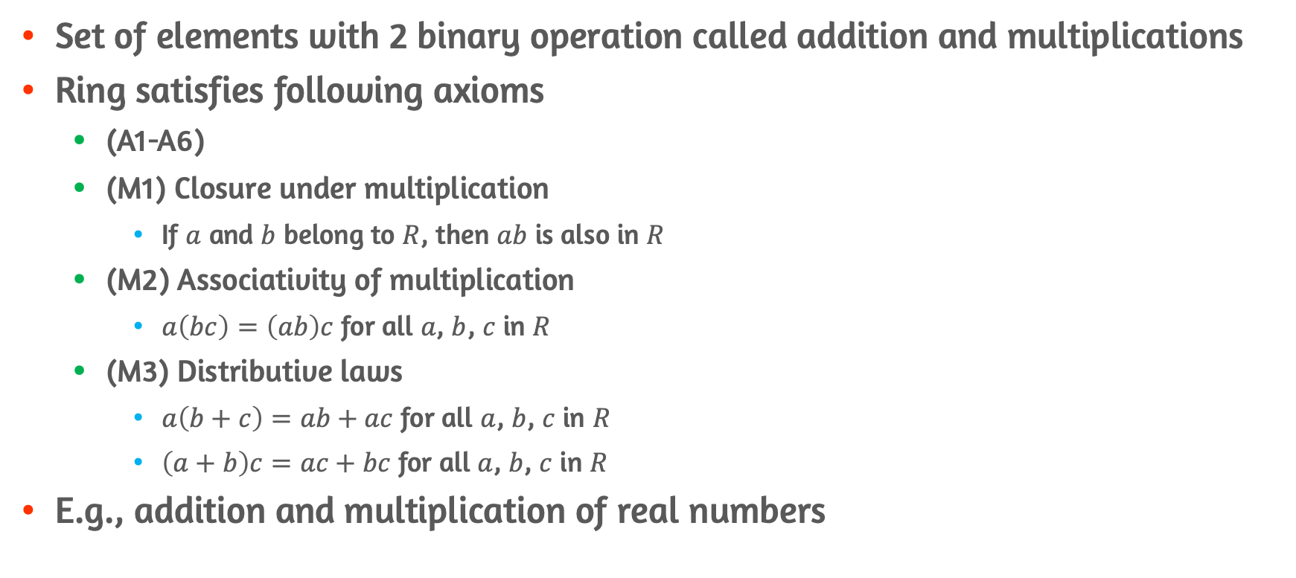

Rings $\{R,+,×\}$
Set of elements with 2 binary operation called addition and multiplications
Ring satisfies following axioms
(A1-A6)
(M1) Closure under multiplication
If $a$ and $b$ belong to $R$, then $ab$ is also in $R$
(M2) Associativity of multiplication
$a\left(bc\right)=\left(ab\right)c$ for all $a$, $b$, $c$ in $R$
(M3) Distributive laws
$a\left(b+c\right)=ab+ac$ for all $a$, $b$, $c$ in $R$
$\left(a+b\right)c=ac+bc$ for all $a$, $b$, $c$ in $R$
E.g., addition and multiplication of real numbers

Slide 22
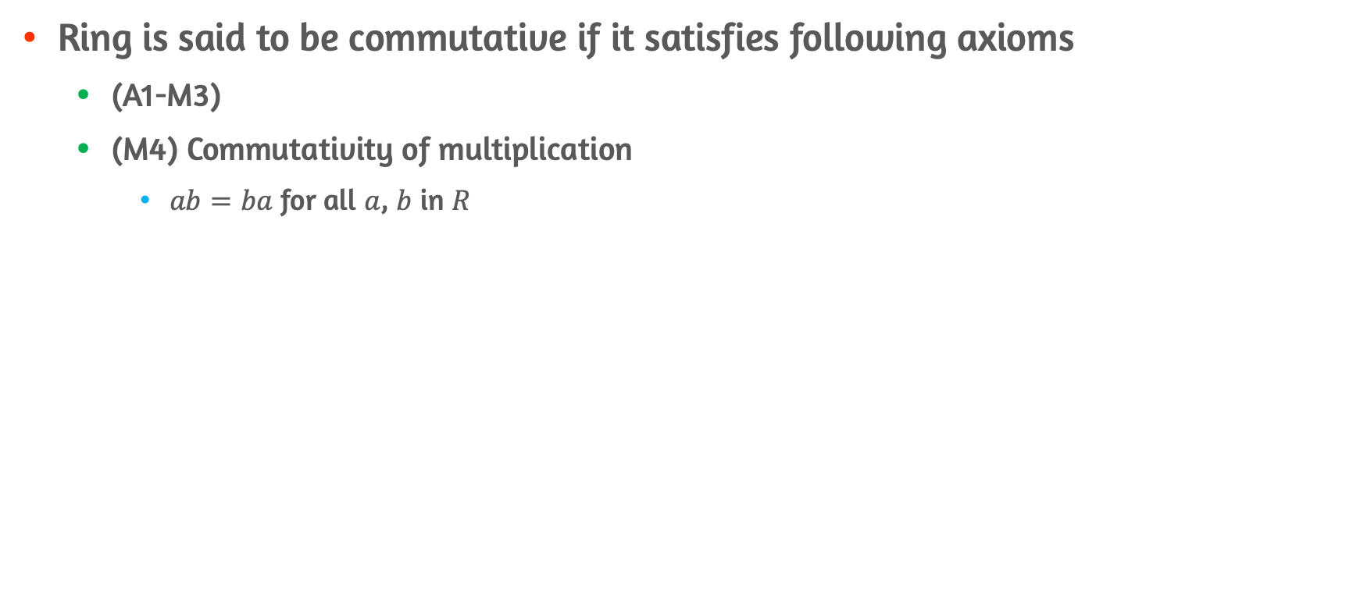
Commutative Ring
Ring is said to be commutative if it satisfies following axioms
(A1-M3)
(M4) Commutativity of multiplication
$ab=ba$ for all $a$, $b$ in $R$

Slide 23
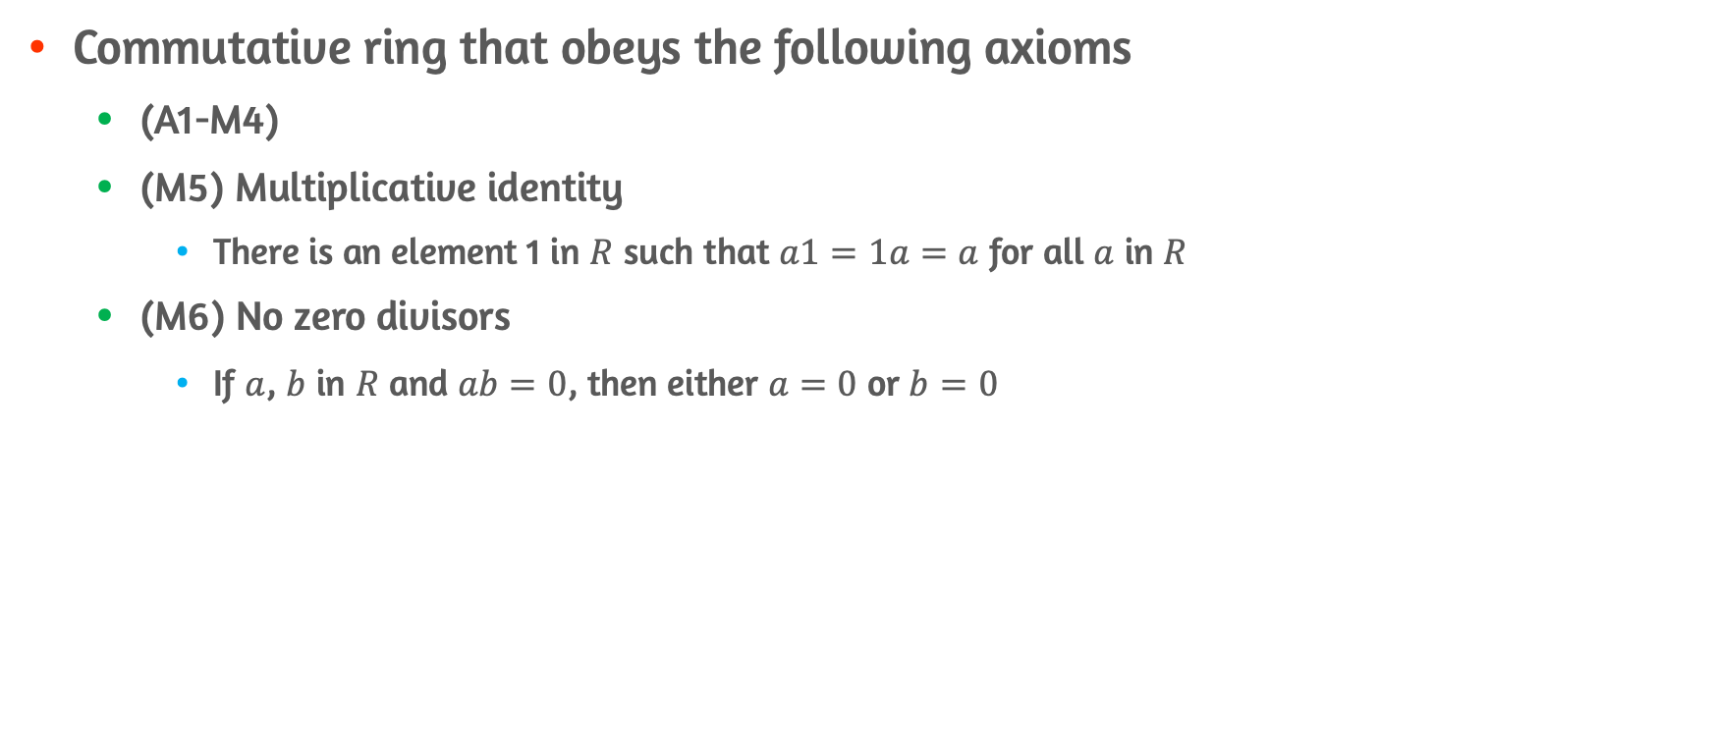
Integral Domain
Commutative ring that obeys the following axioms
(A1-M4)
(M5) Multiplicative identity
There is an element 1 in $R$ such that $a1=1a=a$ for all $a$ in $R$
(M6) No zero divisors
If $a$, $b$ in $R$ and $ab=0$, then either $a=0$ or $b=0$

Slide 24
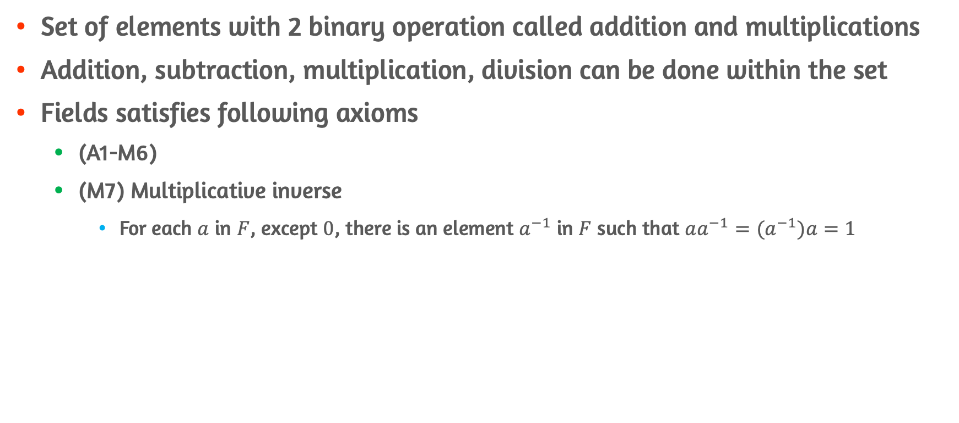

Fields $\{F,+,×\}$
Set of elements with 2 binary operation called addition and multiplications
Addition, subtraction, multiplication, division can be done within the set
Fields satisfies following axioms
(A1-M6)
(M7) Multiplicative inverse
For each $a$ in $F$, except $0$, there is an element $a^{−1}$ in $F$ such that $aa^{−1}=(a^{−1})a=1$

Slide 25
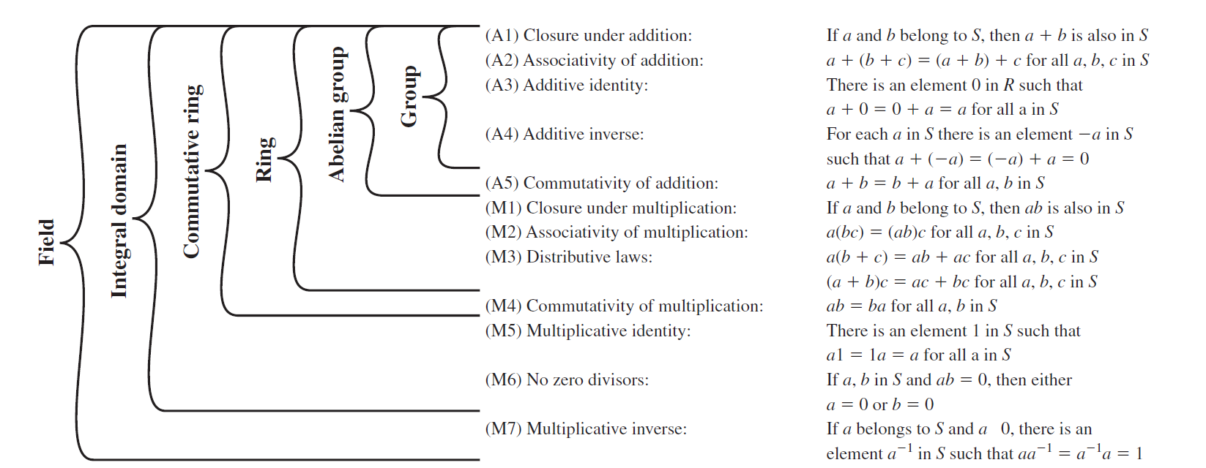
Groups, Rings, Fields

Slide 26
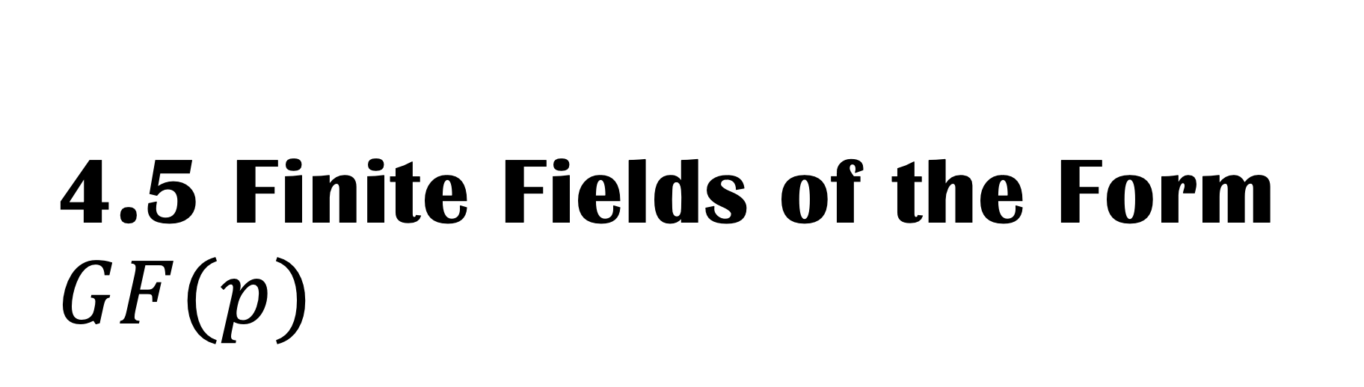
4.5 Finite Fields of the Form $GF(p)$

Slide 27
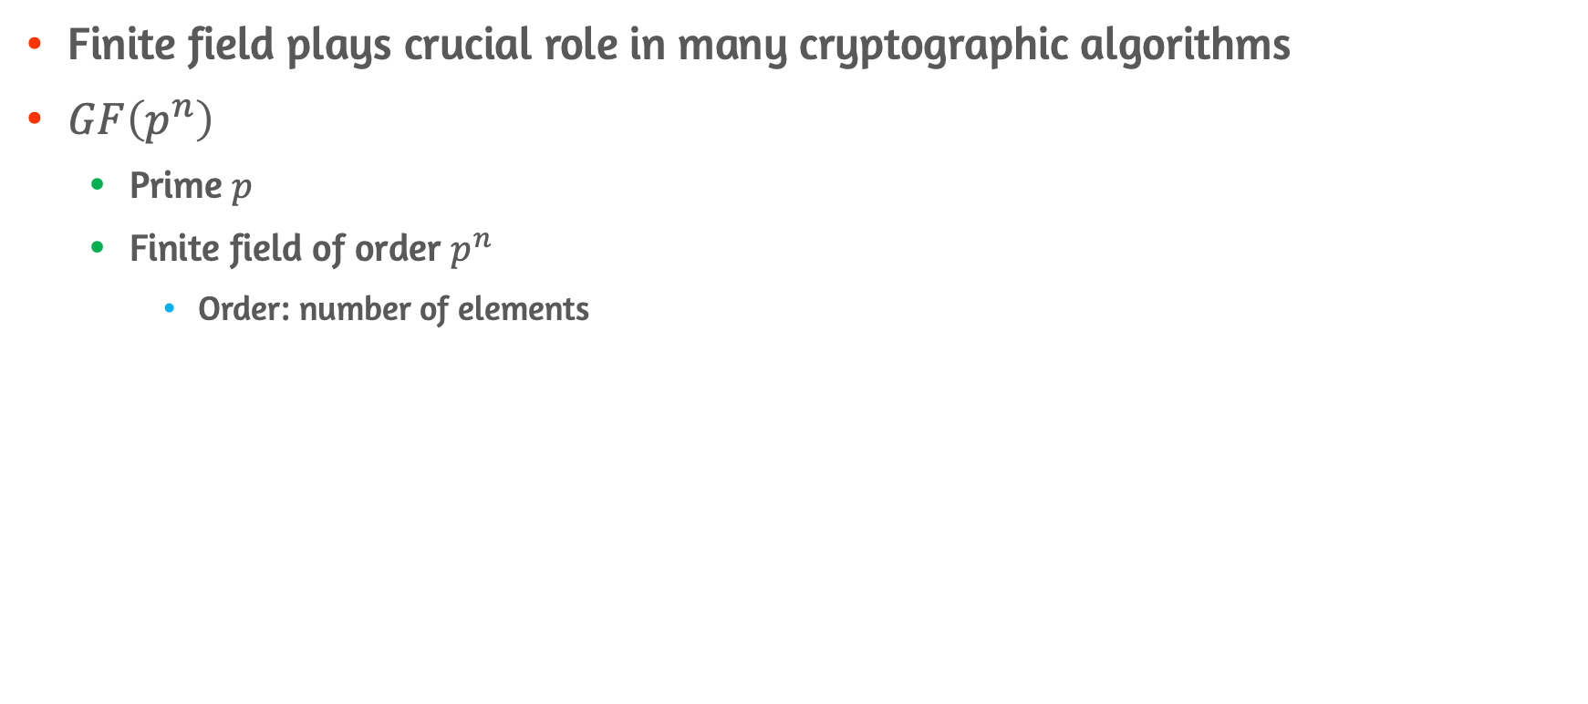
Galois Field
Finite field plays crucial role in many cryptographic algorithms
$GF\left(p^{n}\right)$
Prime $p$
Finite field of order $p^{n}$
Order: number of elements

Slide 28
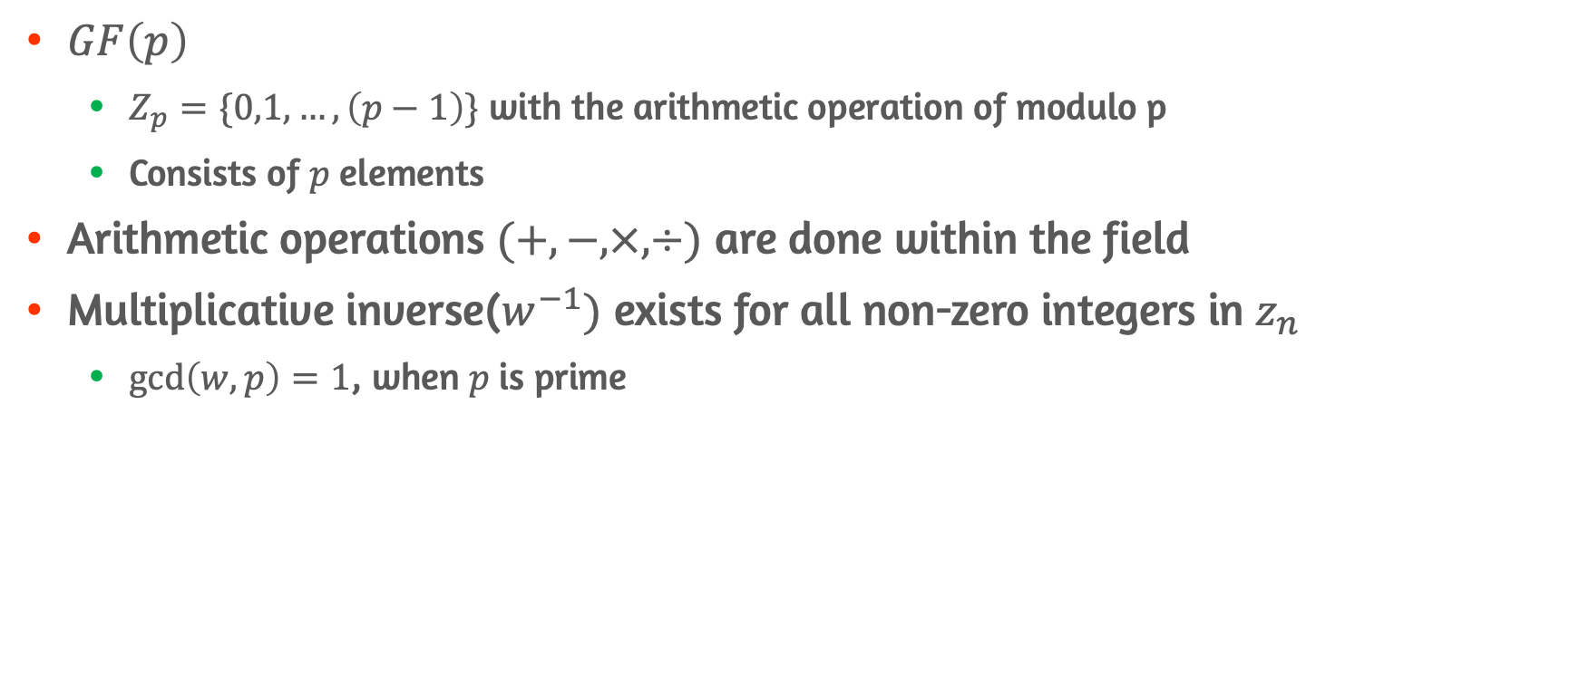
Finite Fields of Order P
$GF\left(p\right)$
$Z_{p}=\{0,1,…,\left(p−1\right)\}$ with the arithmetic operation of modulo p
Consists of $p$elements
Arithmetic operations $(+,−,×,÷)$ are done within the field
Multiplicative inverse($w^{−1})$ exists for all non-zero integers in $z_{n}$
$\gcd\left(w,p\right)=1$, when $p$is prime

Slide 29
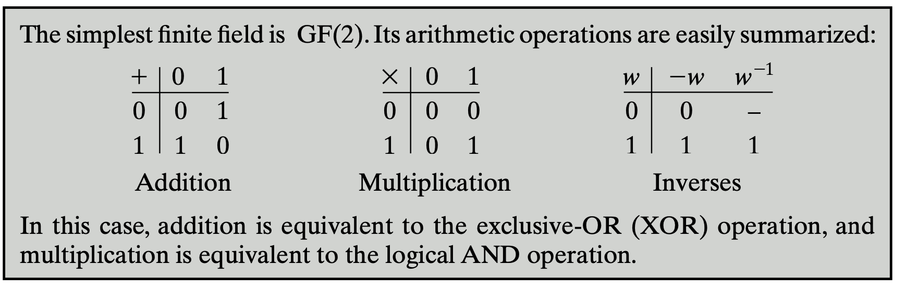
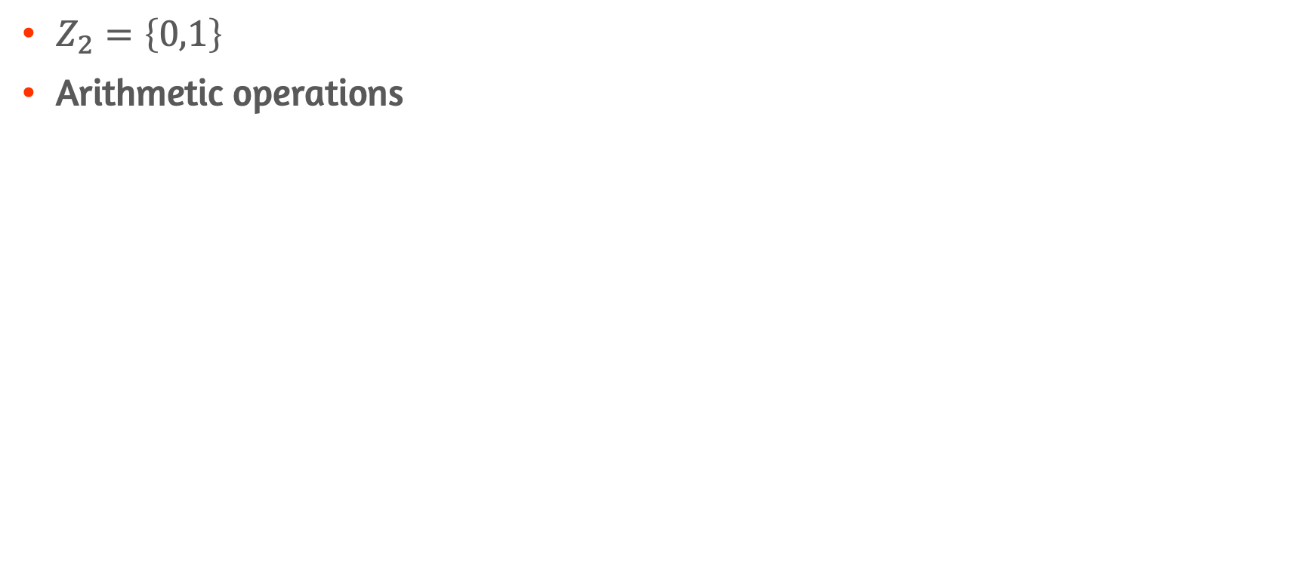

Case of $GF(2)$
$Z_{2}=\left\{0,1\right\}$
Arithmetic operations

Slide 30
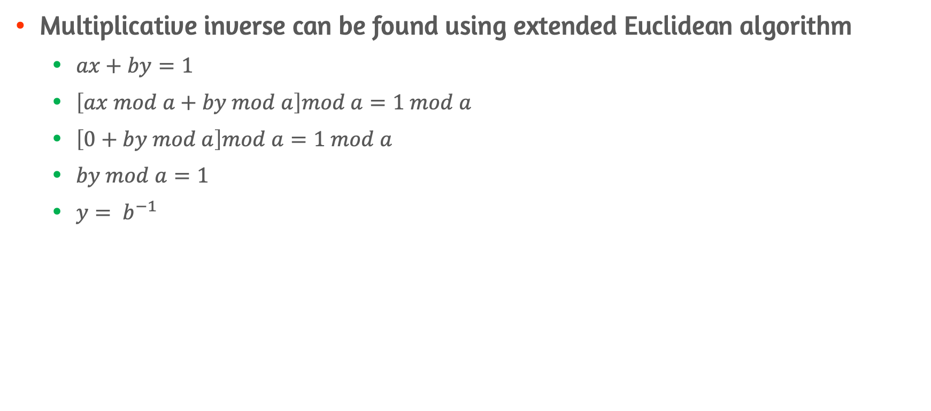
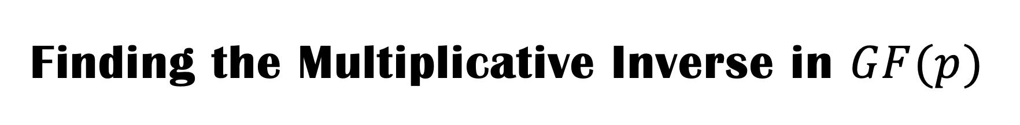
Finding the Multiplicative Inverse in $GF(p)$
Multiplicative inverse can be found using extended Euclidean algorithm
$ax+by=1$
$\left[ax mod a+by mod a\right]mod a=1 mod a$
$\left[0+by mod a\right]mod a=1 mod a$
$by mod a=1$
$y= b^{−1}$

Slide 31
4.6 Polynomial Arithmetic

Slide 32
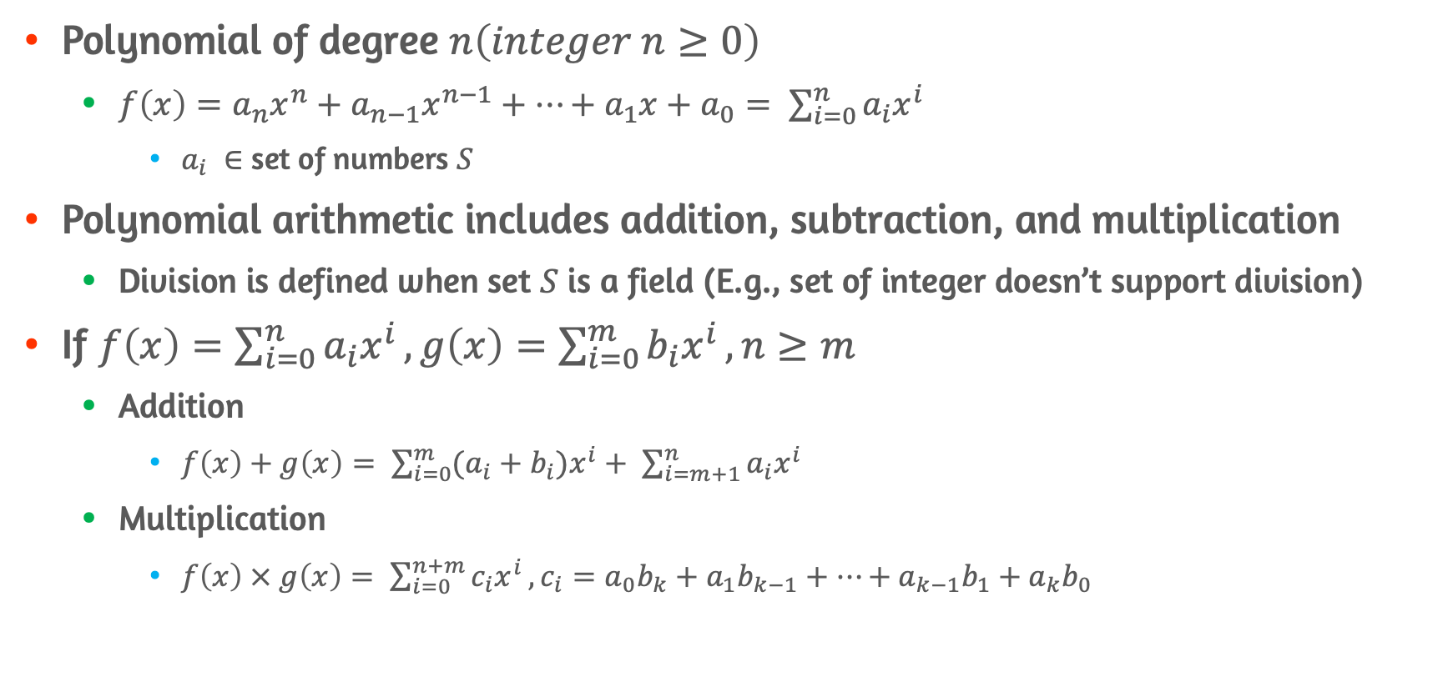
Ordinary Polynomial Arithmetic
Polynomial of degree $n\left(integer n≥0\right)$
$f\left(x\right)=a_{n}x^{n}+a_{n−1}x^{n−1}+…+a_{1}x+a_{0}= \sum_{i=0}^{n}{a_{i}x^{i}}$
$a_{i} ∈$ set of numbers $S$
Polynomial arithmetic includes addition, subtraction, and multiplication
Division is defined when set $S$ is a field (E.g., set of integer doesn’t support division)
If $f\left(x\right)=\sum_{i=0}^{n}{a_{i}x^{i}}, g\left(x\right)=\sum_{i=0}^{m}{b_{i}x^{i}}, n≥m$
Addition
$f\left(x\right)+g\left(x\right)= \sum_{i=0}^{m}{(a_{i}+b_{i})x^{i}}+ \sum_{i=m+1}^{n}{a_{i}x^{i}}$
Multiplication
$f\left(x\right) × g\left(x\right)= \sum_{i=0}^{n+m}{c_{i}x^{i}}, c_{i}=a_{0}b_{k}+a_{1}b_{k−1}+…+a_{k−1}b_{1}+a_{k}b_{0}$

Slide 33
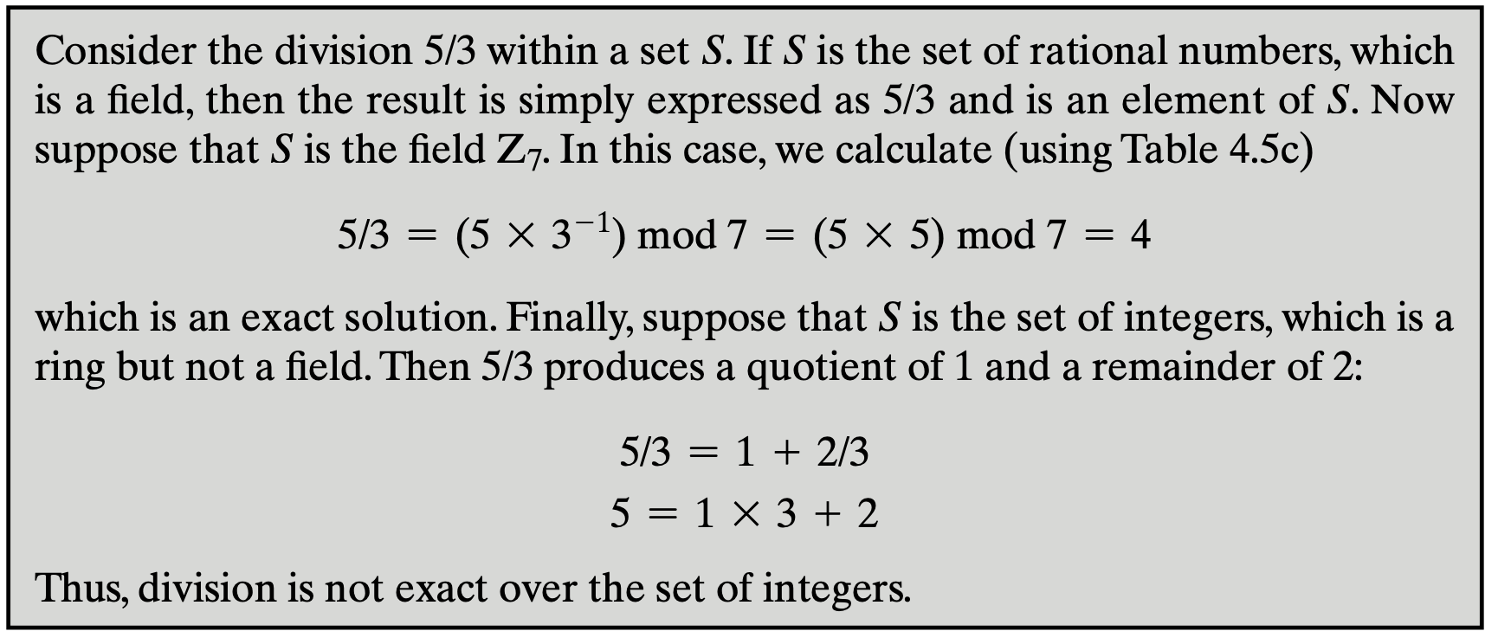
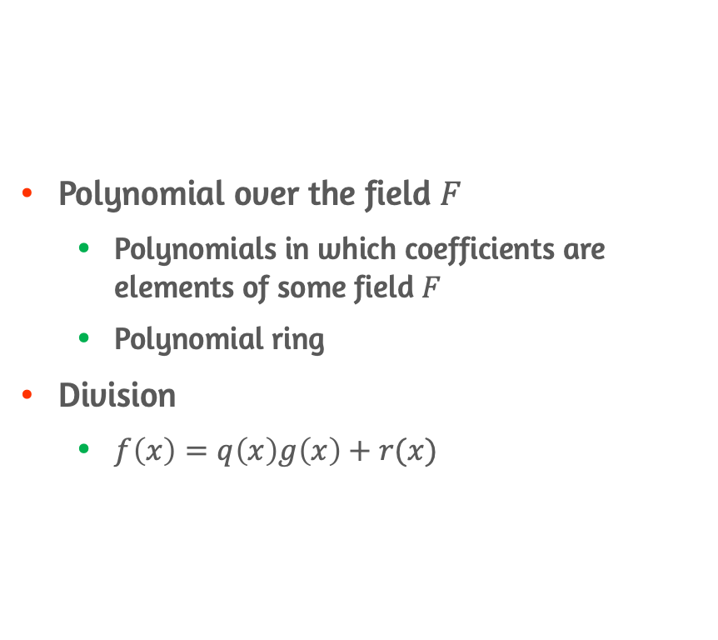
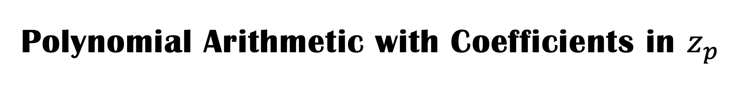
Polynomial Arithmetic with Coefficients in $z_{p}$
Polynomial over the field $F$
Polynomials in which coefficients are elements of some field $F$
Polynomial ring
Division
$f\left(x\right)=q\left(x\right)g\left(x\right)+r(x)$

Slide 34
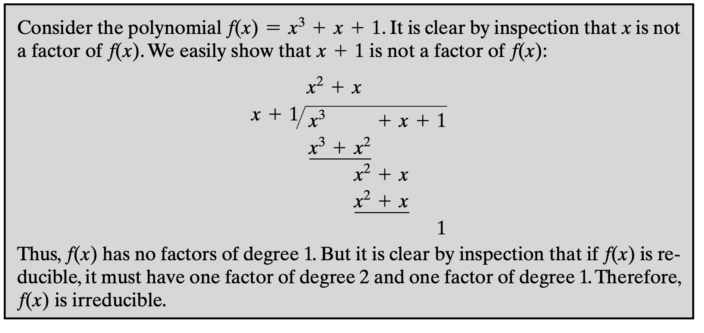
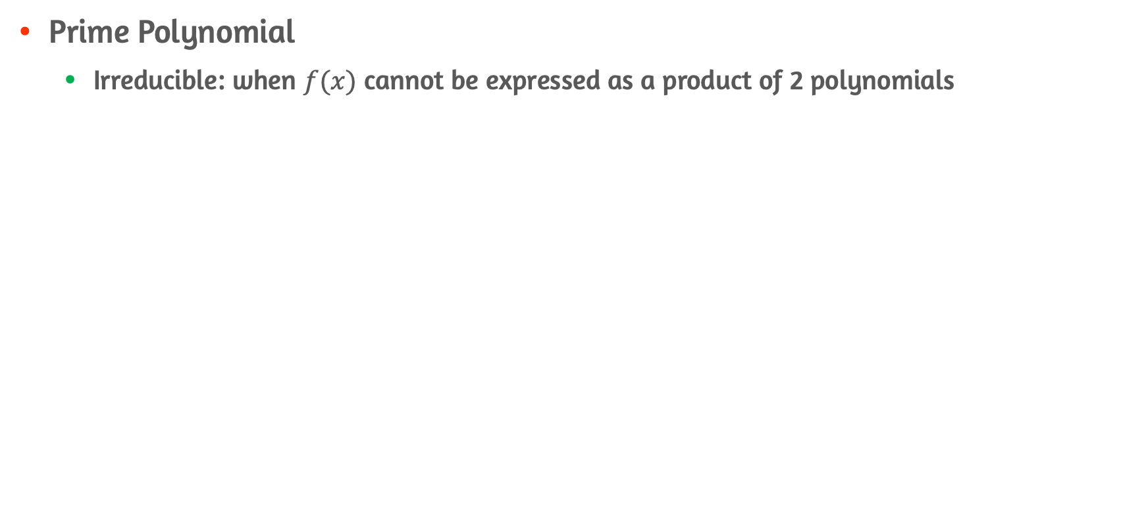
Prime Polynomial
Prime Polynomial
Irreducible: when $f(x)$ cannot be expressed as a product of 2 polynomials

Slide 35
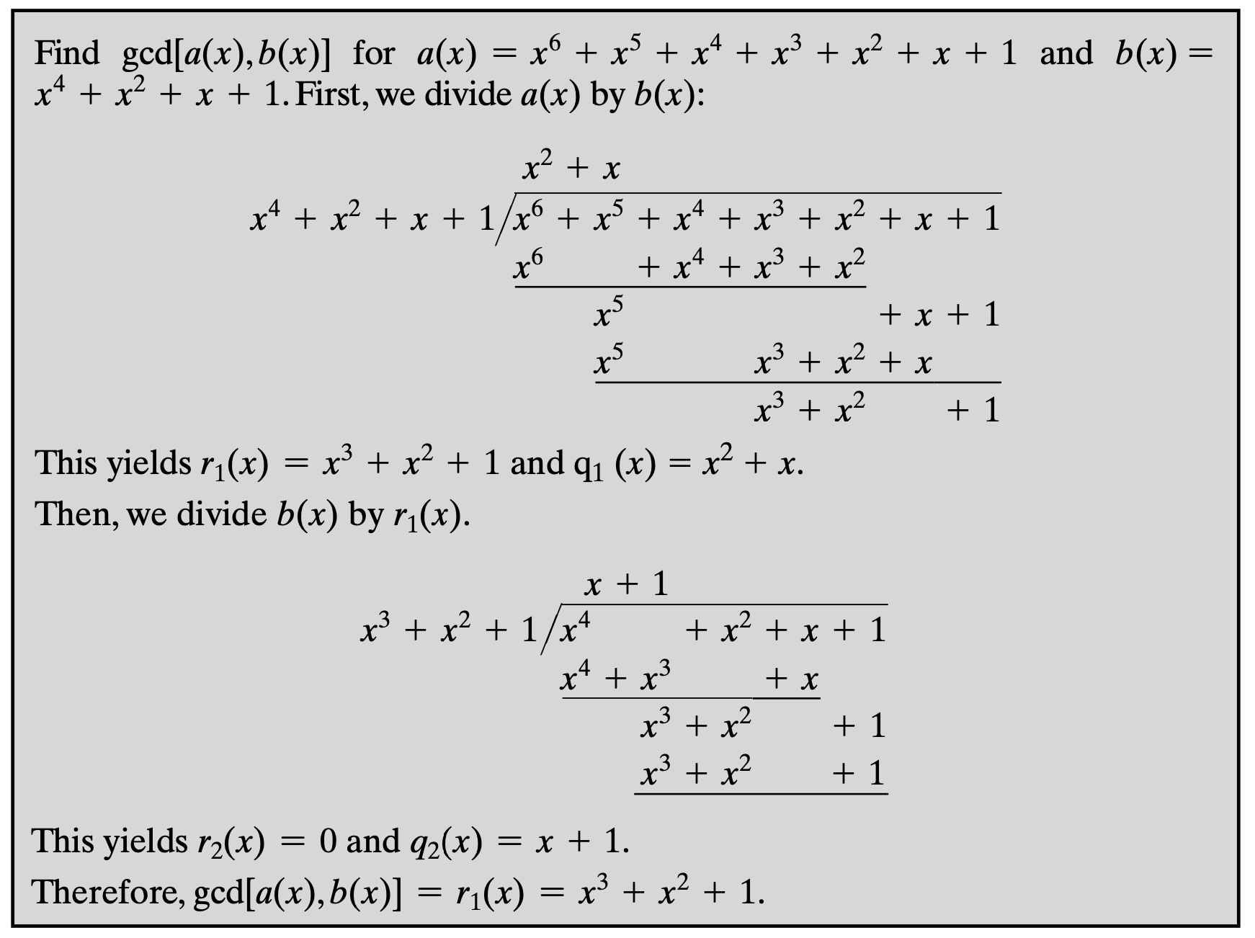
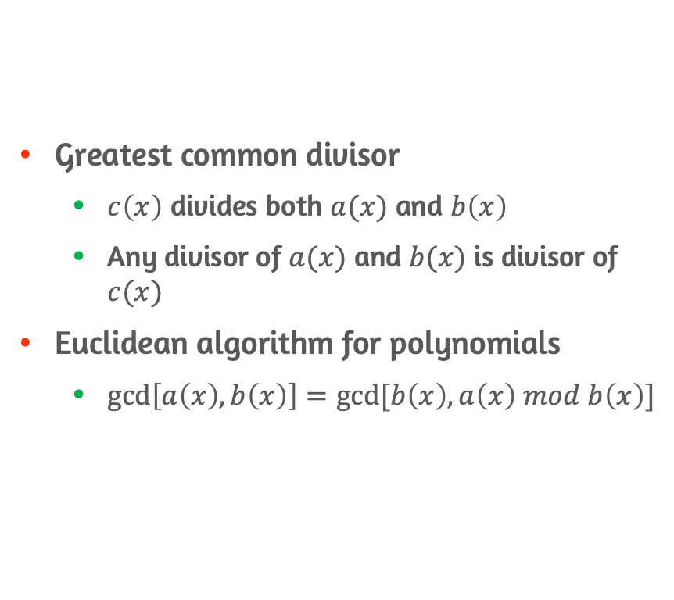
Finding the Greatest Common Divisor
Greatest common divisor
$c\left(x\right)$ divides both $a(x)$ and $b\left(x\right)$
Any divisor of $a(x)$ and $b(x)$ is divisor of $c(x)$
Euclidean algorithm for polynomials
$\gcd\left[a\left(x\right),b\left(x\right)\right]=gcd⁡[b\left(x\right),a\left(x\right) mod b\left(x\right)]$

Slide 36
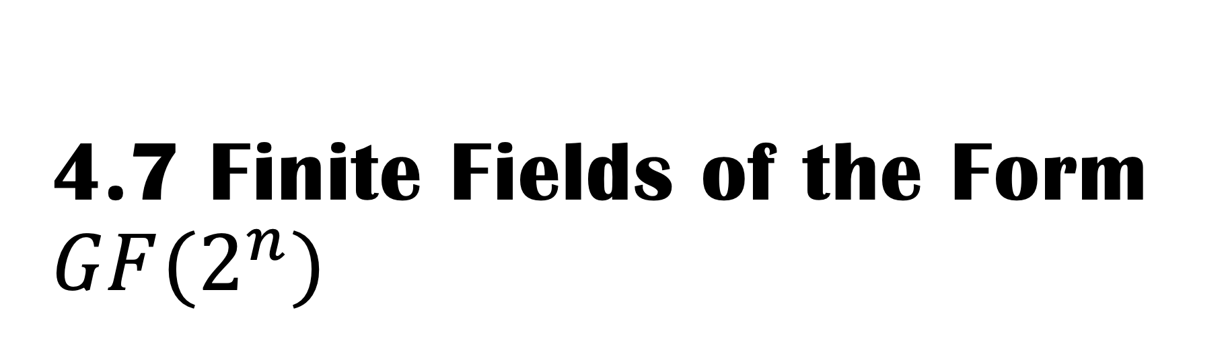
4.7 Finite Fields of the Form $GF(2^{n})$

Slide 37
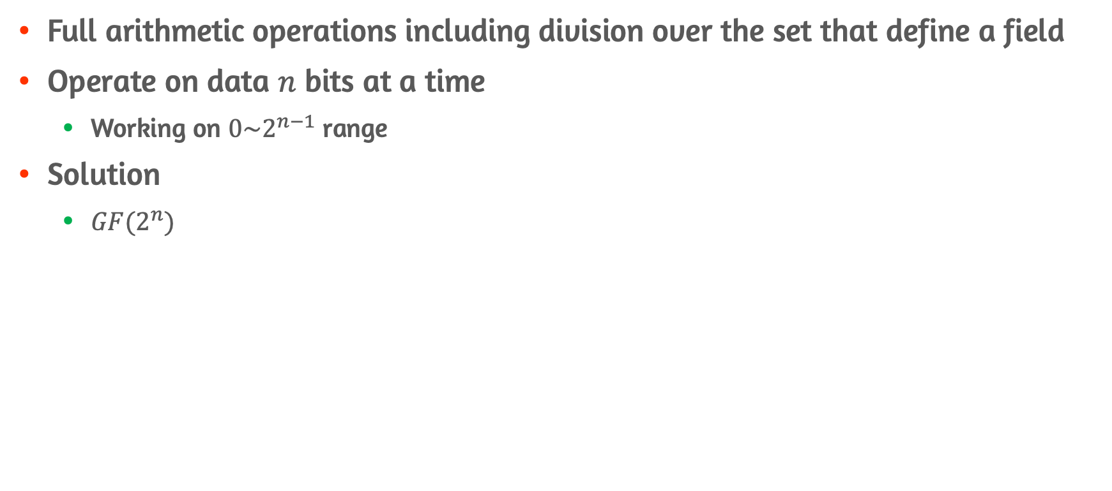
Motivation
Full arithmetic operations including division over the set that define a field
Operate on data $n$ bits at a time
Working on $0\sim 2^{n−1}$ range
Solution
$GF(2^{n})$

Slide 38
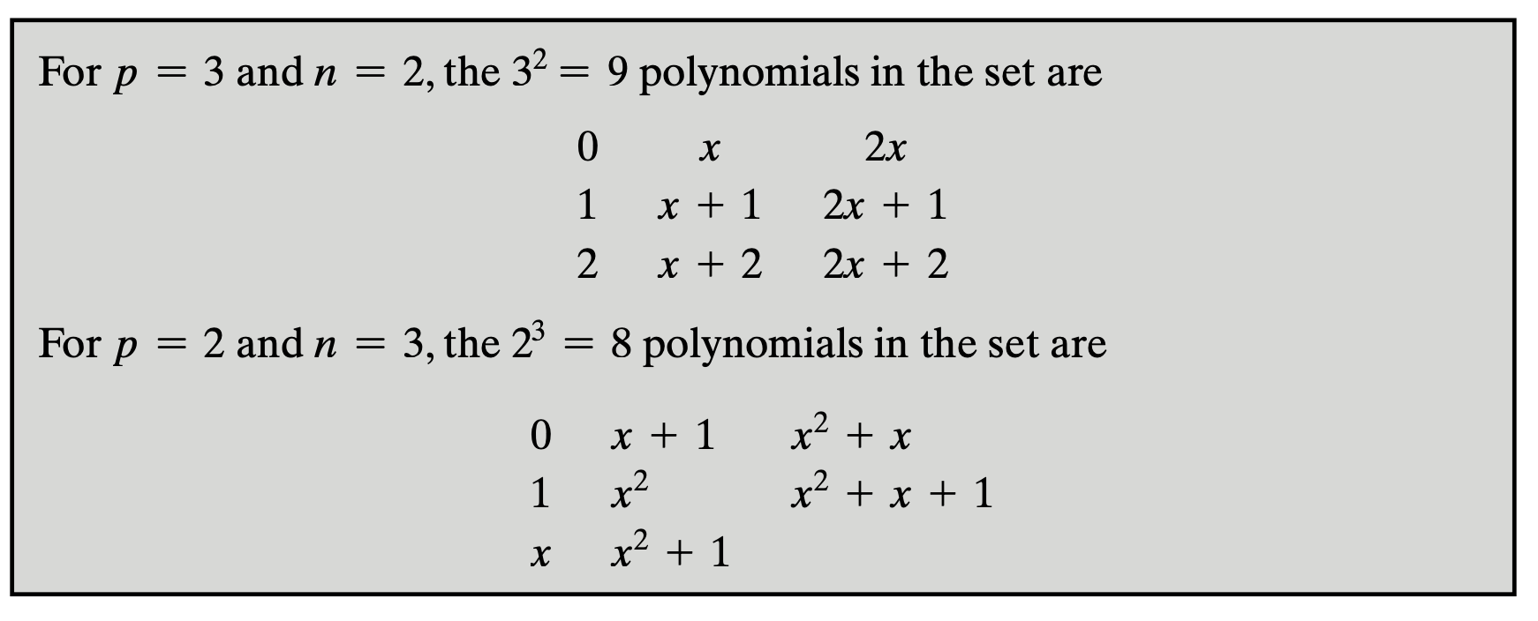
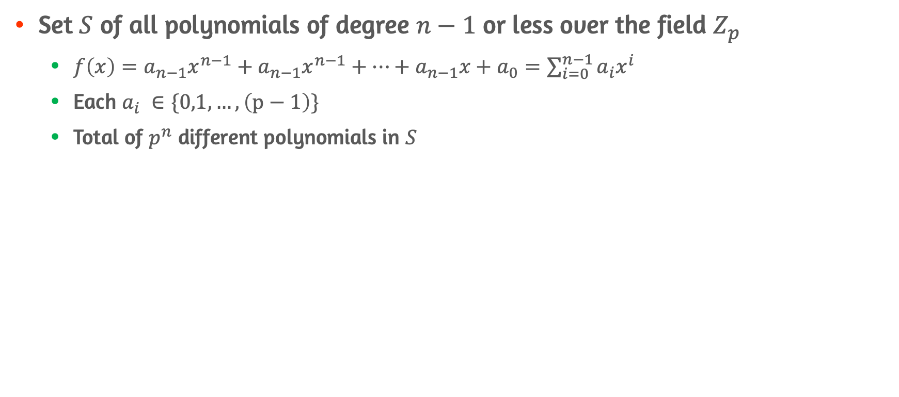
Modular Polynomial Arithmetic
Set $S$ of all polynomials of degree $n−1$ or less over the field $Z_{p}$
$f\left(x\right)=a_{n−1}x^{n−1}+a_{n−1}x^{n−1}+…+a_{n−1}x+a_{0}=\sum_{i=0}^{n−1}{a_{i}x^{i}}$
Each $a_{i} ∈\{0,1,…,\left(p−1\right)\}$
Total of $p^{n}$ different polynomials in $S$

Slide 39
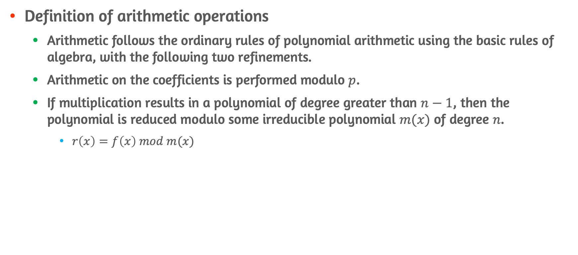
Modular Polynomial Arithmetic Operations
Definition of arithmetic operations
Arithmetic follows the ordinary rules of polynomial arithmetic using the basic rules of algebra, with the following two refinements.
Arithmetic on the coefficients is performed modulo $p$.
If multiplication results in a polynomial of degree greater than $n−1$, then the polynomial is reduced modulo some irreducible polynomial $m(x)$ of degree $n$.
$r\left(x\right)=f\left(x\right) mod m(x)$

Slide 40
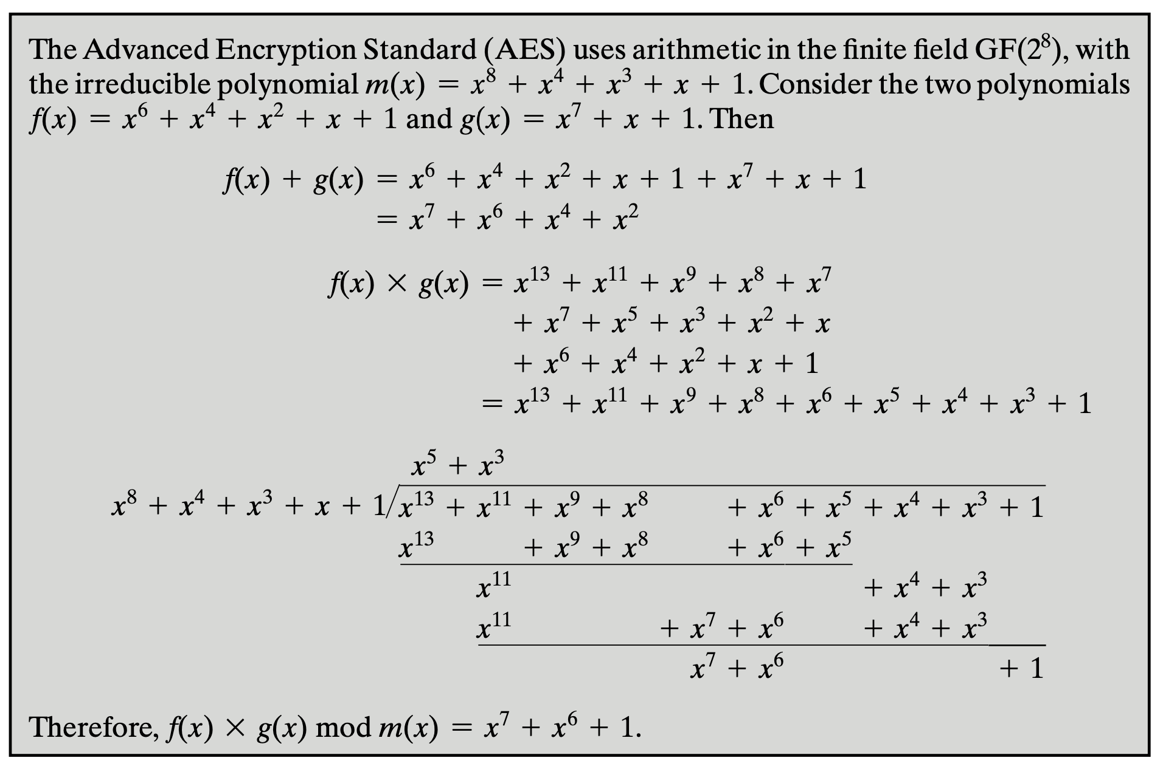
Modular Polynomial Arithmetic(example)

Slide 41
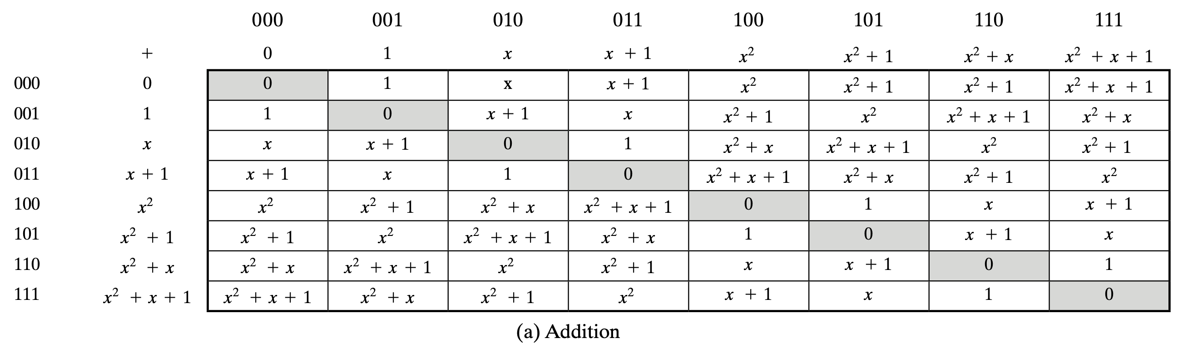


Example of Addition on $GF(2^{3})$
$GF\left(2^{3}\right)$ with Polynomial Arithmetic Modulo $(x^{3}+x+1)$ - addition

Slide 42



Example of Multiplication on $GF(2^{3})$
$GF\left(2^{3}\right)$ with polynomial arithmetic modulo $(x^{3}+x+1)$ - multiplication

Slide 43


Finding the Multiplicative Inverse
If $a\left(x\right)$ is irreducible polynomial, it has no factor other than itself or $1$
$\gcd\left[a\left(x\right),b\left(x\right)\right]=1, degree of b\left(x\right)<degree of a(x)$
Extended Euclidean algorithm
$a\left(x\right)v\left(x\right)+b\left(x\right)w\left(x\right)=d\left(x\right), d\left(x\right)=1$

Slide 44


Computational Considerations $GF(2^{n})$ #1
Addition works as XOR operation

Slide 45



Computational Considerations $GF(2^{n})$ #2
Multiplication
$x^{n} mod p\left(x\right)=[p\left(x\right)−x^{n}]$
Case of $GF\left(2^{8}\right), p\left(x\right)={x^{8}+x}^{4}+x^{3}+x+1$

Slide 46


Computational Considerations $GF(2^{n})$ #3

Slide 47

Using a Generator
Generator $g$ of order $q$
Element whose first $q−1$ powers generate all the nonzero elements of $F$
$F=\{0,g^{0},g^{1},…,g^{q−2}\}$
Root $g$ of irreducible polynomial is a generator of the finite field defined on that polynomial
Root of polynomial
If $f\left(b\right)=0$ and $b ε F$, $b$ is called root of polynomial
Not interested in the value of b itself
Usage of generator $g$
$g^{n}=f\left(g\right)−g^{n}$
Calculate all of the powers of $g^{n+1}$ through $g^{2^{n}−2}$
Resulting $g^{k}=g^{k mod \left(2^{n}−1\right)}$

Slide 48



Example of Using Generator

Slide 49

Conclusion
Concept of divisibility and the division algorithm
Concepts of modular arithmetic
Concepts of group, rings, and field and their distinguishment
Using Euclidean algorithm to acquire gcd
Using extended Euclidean algorithm to acquire multiplicative inverse
Properties and arithmetic operations over finite fields of form $GF\left(p\right)$
Properties and arithmetic operations over:
Polynomial arithmetic
Polynomial arithmetic with coefficient in $Z_{p}$
Modular polynomial arithmetic in $GF\left(2^{n}\right)$
Need of finite field of $GF(2^{n})$ and its’ computations

